Slide 1
Spatial Roles in Hockey Special Teams
Jonathan Arsenault, Margaret Cunniff, Eric Tulsky and James Richard Forbes

Slide 2
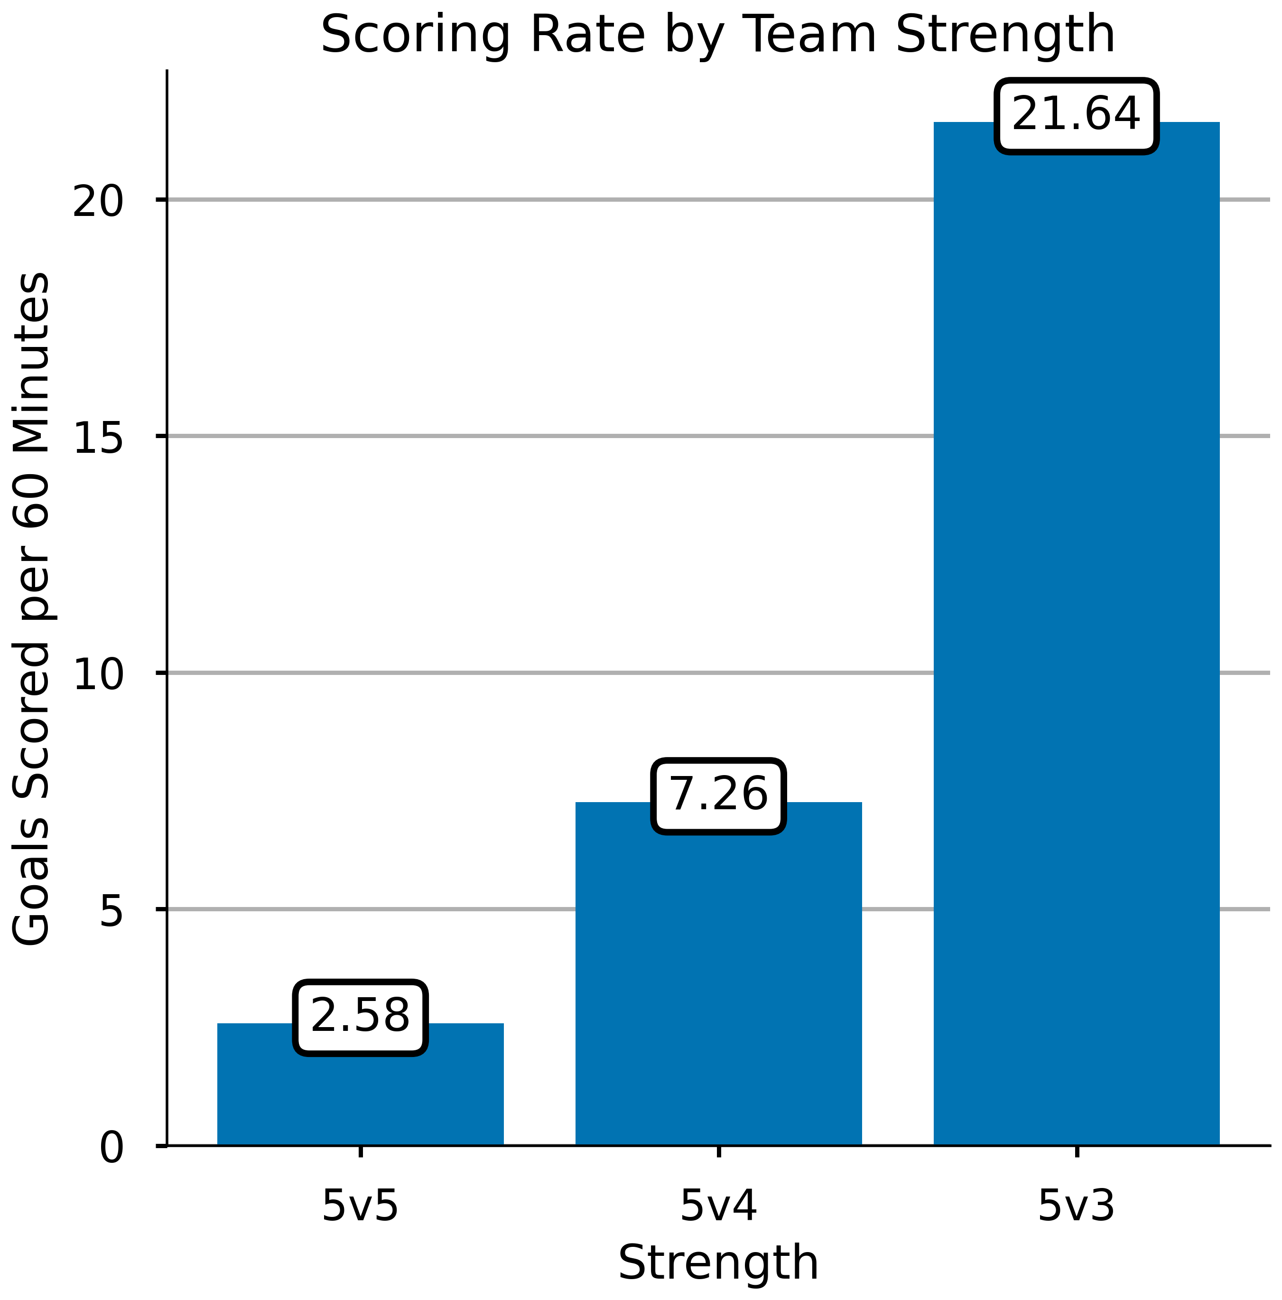
What makes special teams special?
Fewer defenders
More time and space
Increased scoring rates
Notes:
What makes special teams special? From the perspective of the offensive team, there are fewer defenders, which leads to more time and space, which in turn leads to increased scoring rates. Scoring rates almost triple at 5v4 when compared to 5v5 and triple again when comparing 5v3 situations to 5v4 situations.

Slide 3
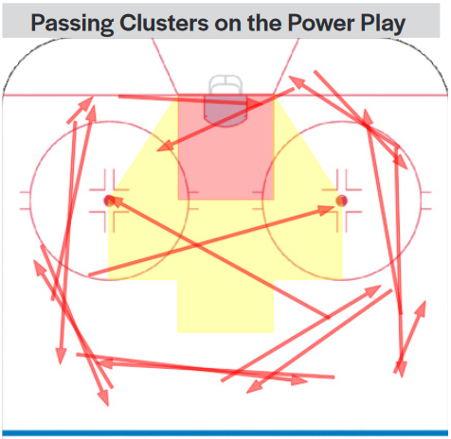
Special Teams Research
How have analytical tools been used to inform and evaluate special teams tactics?
Four forward power play [1]
Importance of structure [2]
Passing patterns [3]
[3] B. Brill and W. Mosher, “Passing Patterns, Passing Efficiency and Expected Goals on the Power Play,” presented at the 2021 Big Data Cup, 2021.
Objective: Develop new analytical tools for special teams that leverage tracking data.
[1] M. Cane, “Why teams should use 4 forwards on the powerplay,” Hockey Graphs, 2015.
[2] A. Parnass, “How Can We Quantify Power Play Performance In Formation?,” Hockey-Graphs, Apr. 25, 2016.
Notes:
Given their outsize importance to game outcomes, there has been a lot of focus on special teams tactics. Data-driven analysis of special teams has recently gained acceptance as a way of augmenting the coaching staffs expert knowledge. How have these analytical tools been used to inform and evaluate special teams tactics? The widespread adoption of the four forward powerplay is one example. Work has also been done on the importance of structure on the power play and on power play passing patterns.
The objective of our work is to develop new analytical tools that specifically leverage player and puck tracking data that only recently became available for NHL games.

Slide 4
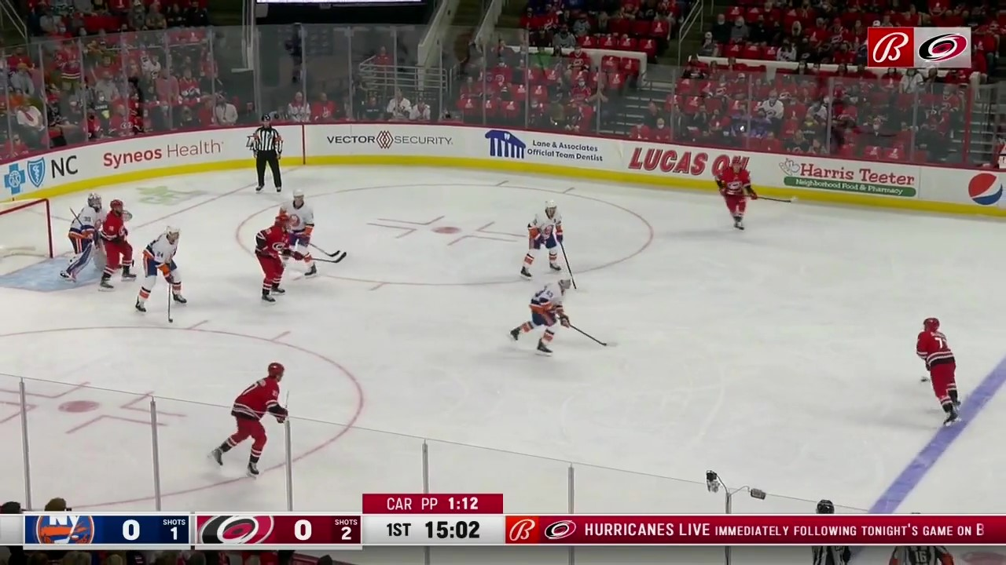
Player Positioning
Right
Net Front
Point
Slot
Left
Notes:
We specifically chose to focus our work on player positioning during special teams possessions. Hockey already has the vocabulary for describing player positioning on the power play. In this picture, we can identify the player playing the net front, one playing the slot, one player on the left and one the right, and the player at the point. Can we use data to identify and evaluate these positioning trends?

Slide 5
Research Objective
Specific Objective: Develop a framework for identifying patterns in player positioning on special teams.
Leverage player tracking data to
improve upon methods that use events to identify patterns in offensive player positioning, and
investigate the positioning of defensive players.
Roles and Formations
Net Front
Right
Point
Slot
Left
Notes:
This brings to the more specific objective of our work, which is to develop a framework for analyzing player positioning on special teams. In particular, we want to leverage player tracking data to improve upon event-based methods for identifying patterns in offensive player positioning, and investigate the positioning of defensive players.

Slide 6
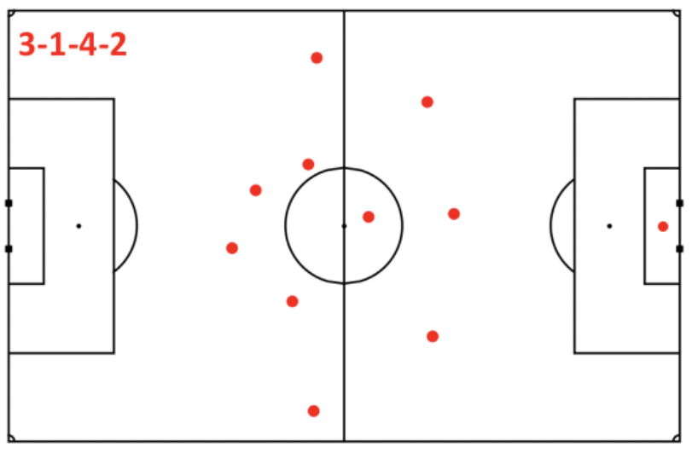
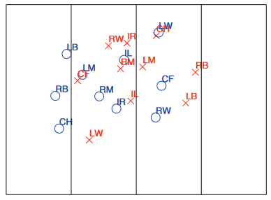
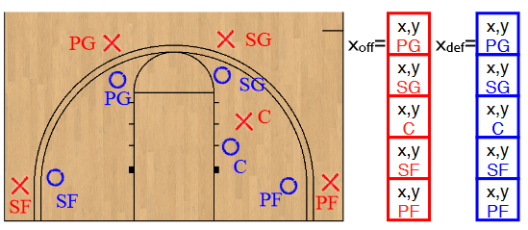
Roles and Formations
Soccer
Field Hockey
L. Shaw and M. Glickman, “Dynamic analysis of team strategy in professional football,” Barça Sports Analytics Summit, pp. 1–13, 2019.
Basketball
P. Lucey et al., “Representing and Discovering Adversarial Team Behaviors Using Player Roles,” in Proc. 2013 IEEE Conf. on Computer Vision and Pattern Recognition (CVPR), 2013, pp. 2706–2713.
P. Lucey et al., “``How to Get an Open Shot’’: Analyzing Team Movement in Basketball using Tracking Data,” in MIT Sloan Sports Analytics Conference, 2014, pp. 1–8.
Notes:
Roles and formations have been extensively studied in other sports. We drew inspiration from work in field hockey, soccer and basketball to develop our own method of studying this problem.

Slide 7
Roles and Formations
Our approach
Identify sequences when the power play is in formation.
Define roles from data using non-negative matrix factorization.
Assign each player a unique role at each time point by solving a linear assignment problem.
Cluster roles together to facilitate the analysis of player deployment.
Notes:
As is on slide

Slide 8



Data
956 games from the 2021-2022 NHL season are used.
Player locations from SMT tracking data are available at 10Hz.
Situations with 5 offensive skaters and 4 defensive skaters are considered.
Shots data, including time and location, is from Sportlogiq.
Notes:
Before we move on, a few notes on the data used in this work. We had a sample of 956 games from the 2021-2022 NHL season. Player locations from SMT tracking data are available at 10Hz. We only considered situations with 5 offensive skaters and 4 defensive skaters. Lastly, shots data, including time and location, is from SportLogiq.

Slide 9
Defining and Identifying Possessions
Identify sequences when the power play is in formation.
Define roles from data using non-negative matrix factorization.
Assign each player a unique role by solving a linear assignment problem.
Cluster roles together to facilitate the analysis of player deployment.

Slide 10
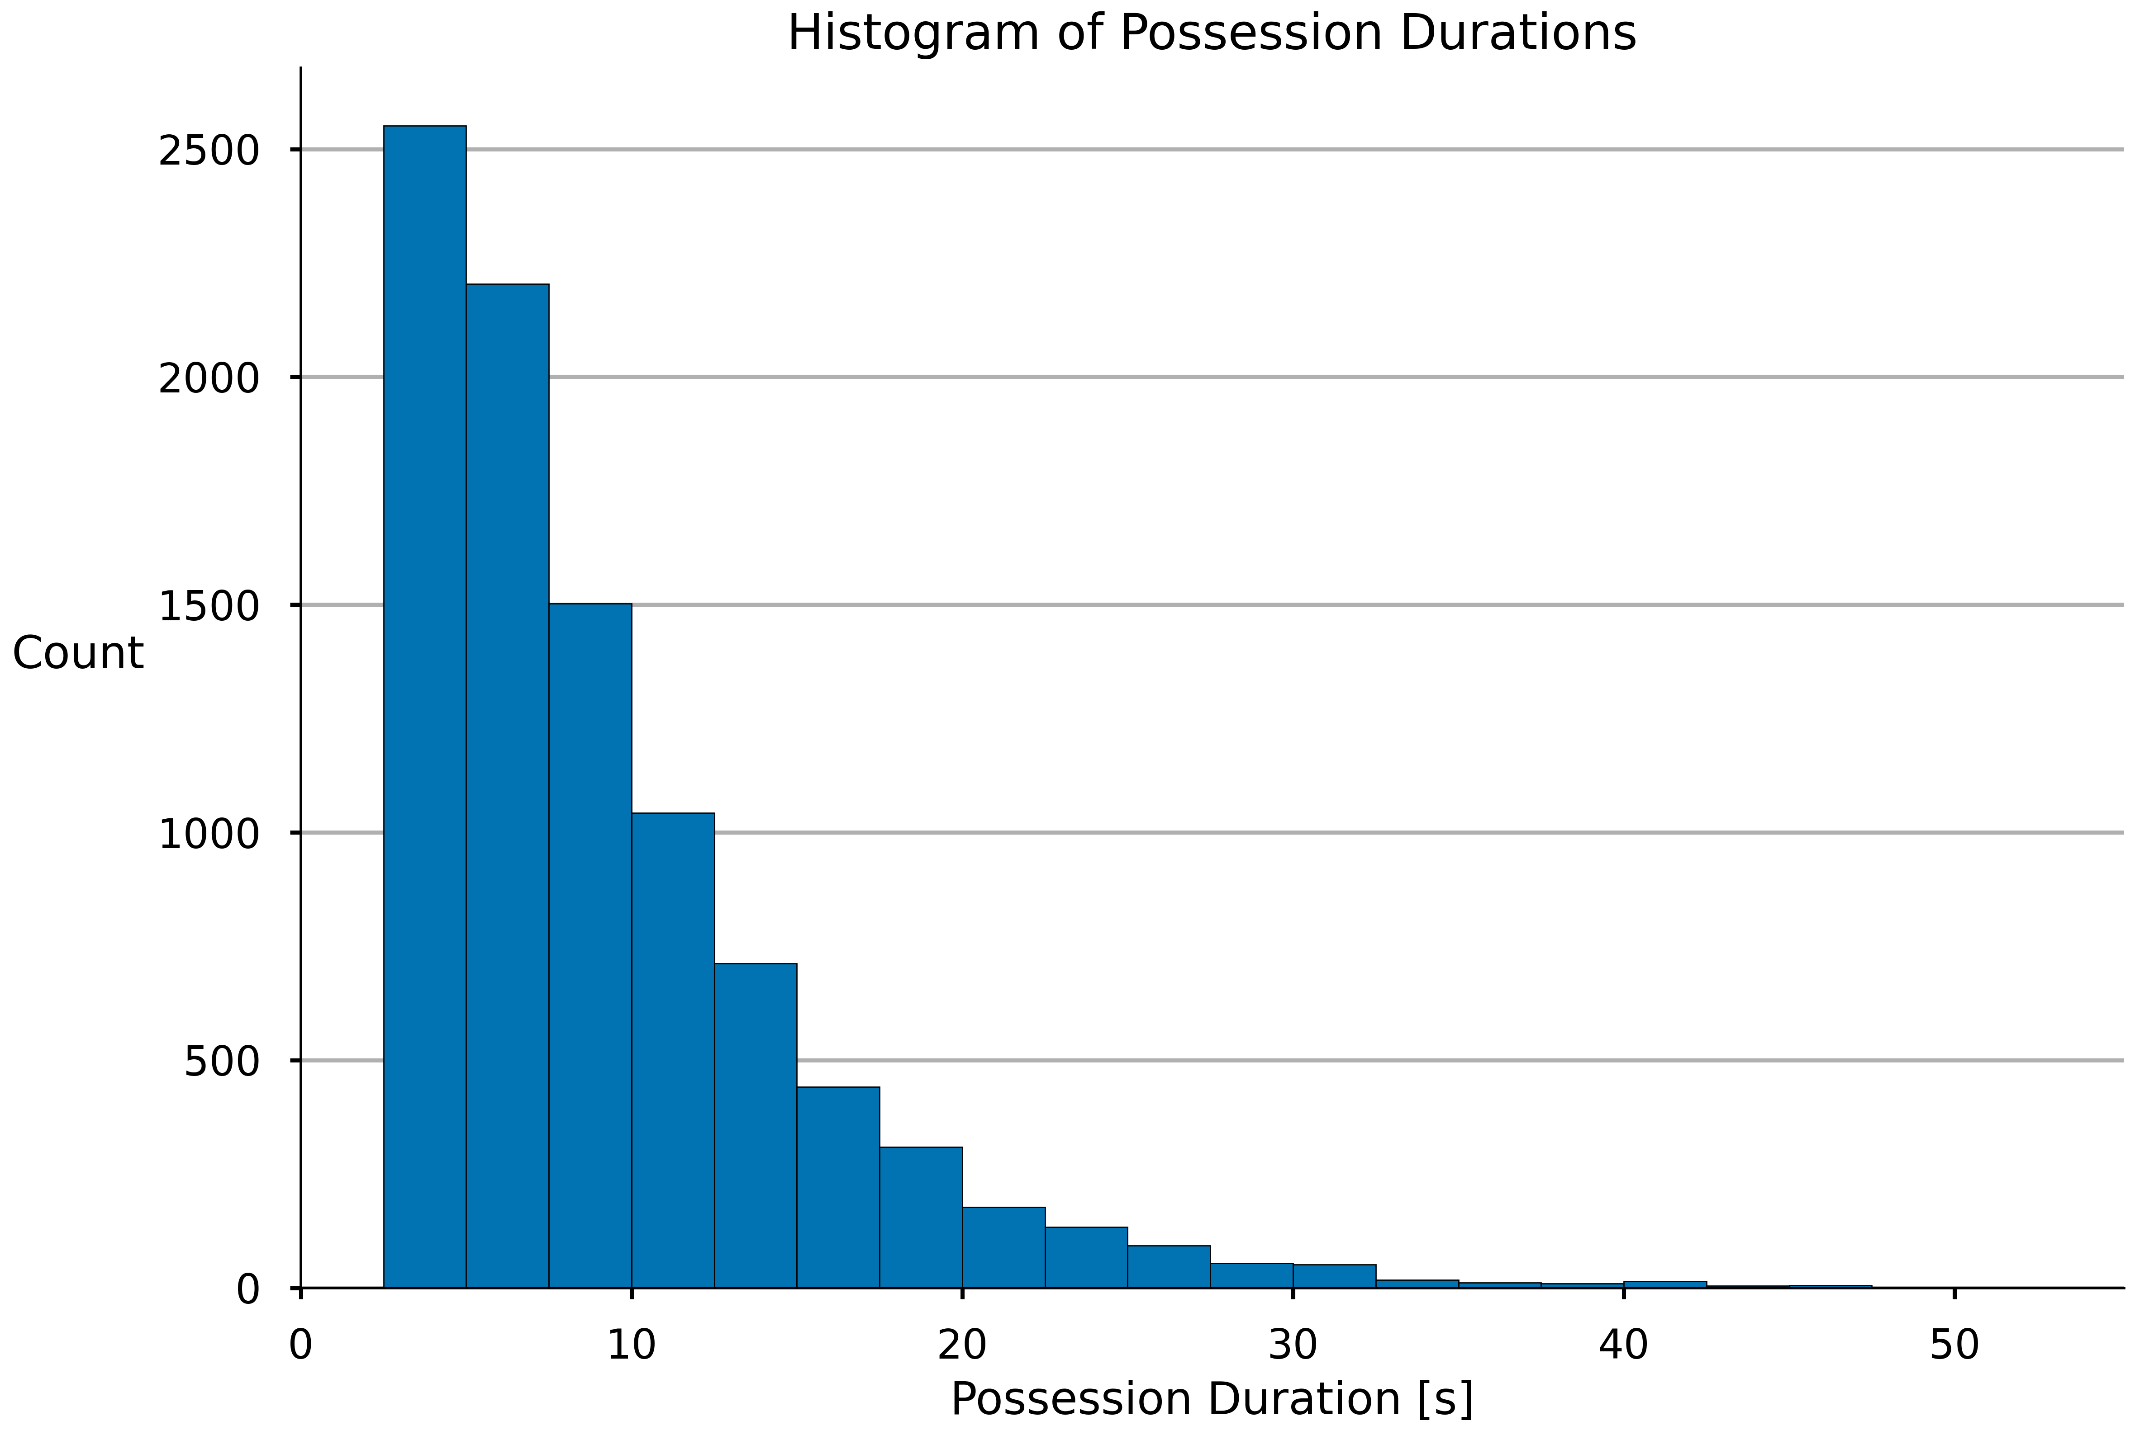
Defining and Identifying Possessions
Possessions: Continuous segments of play where the offensive team has organized their power play.
Three criteria:
5 offensive players are in their offensive zone.
4 defensive players are in their defensive zone.
The offensive team maintains possession of the puck.
Additional steps:
Trim first 2s of possessions to allow time to organize.
Discard any possessions lasting less than 3s.
This yields 9347 possessions with an average duration of 9.2s.
Notes:
We define possessions as continuous segments of play where the offensive team has organized their power play. Initially, we use three criteria to find possessions. We are looking for segments of play where there are 5 offensive players in their offensive zone, 4 defensive players in their defensive zone and the offensive team maintains possession of the puck. This yields 22566 possessions with an average duration of 5.6s.

Slide 11
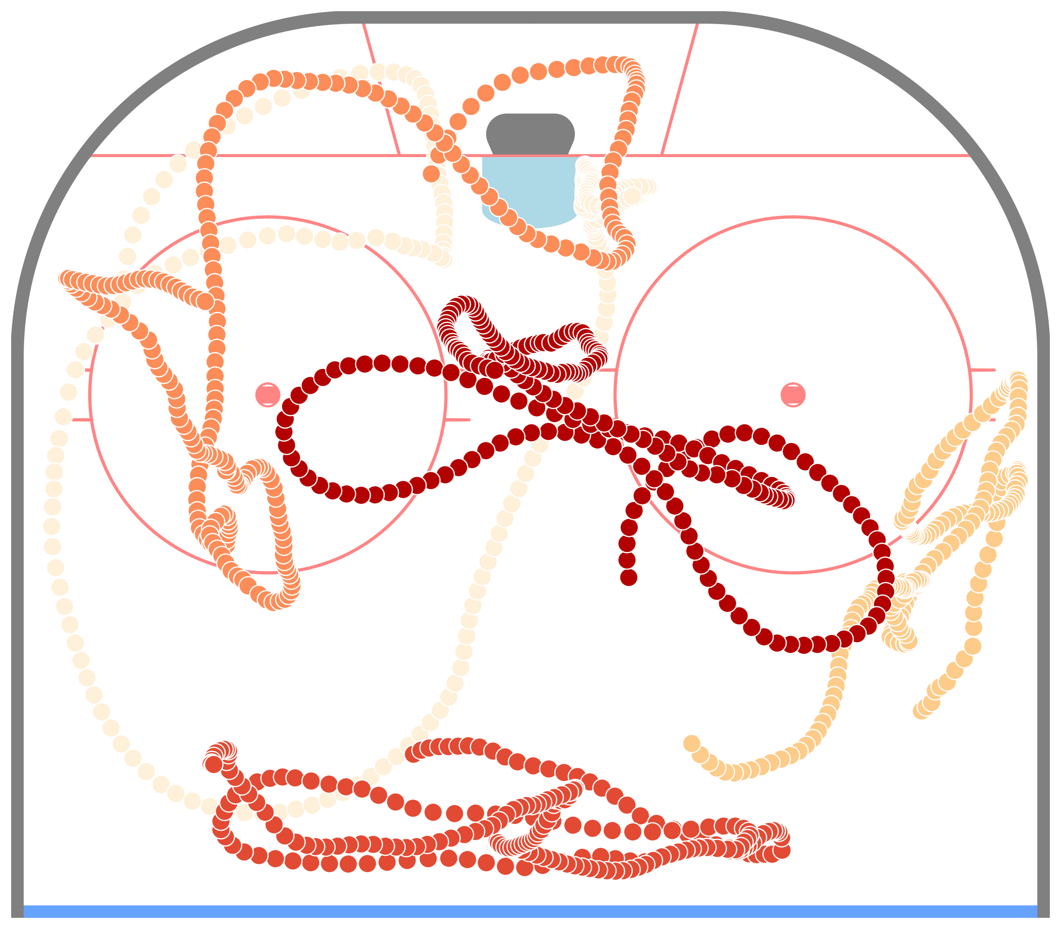
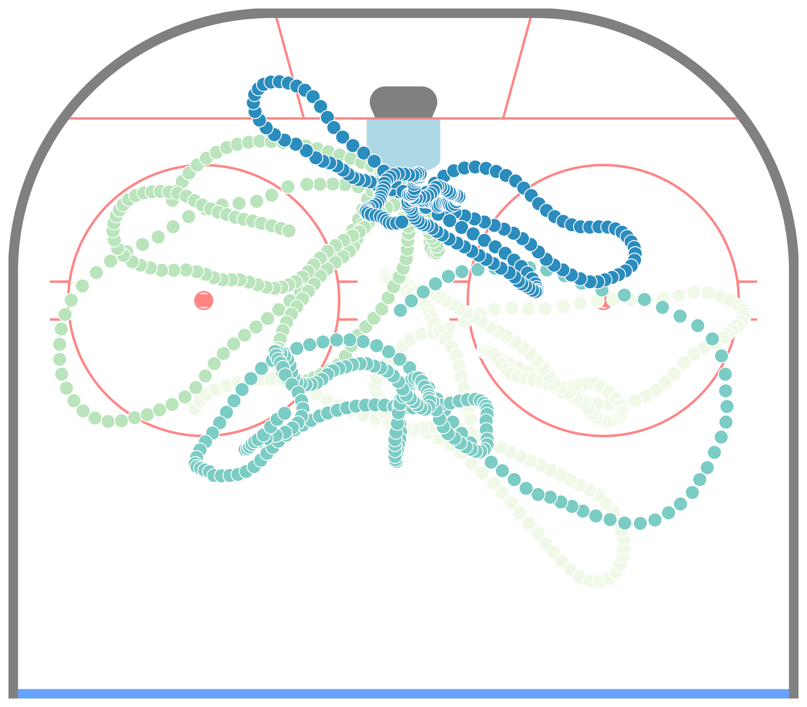
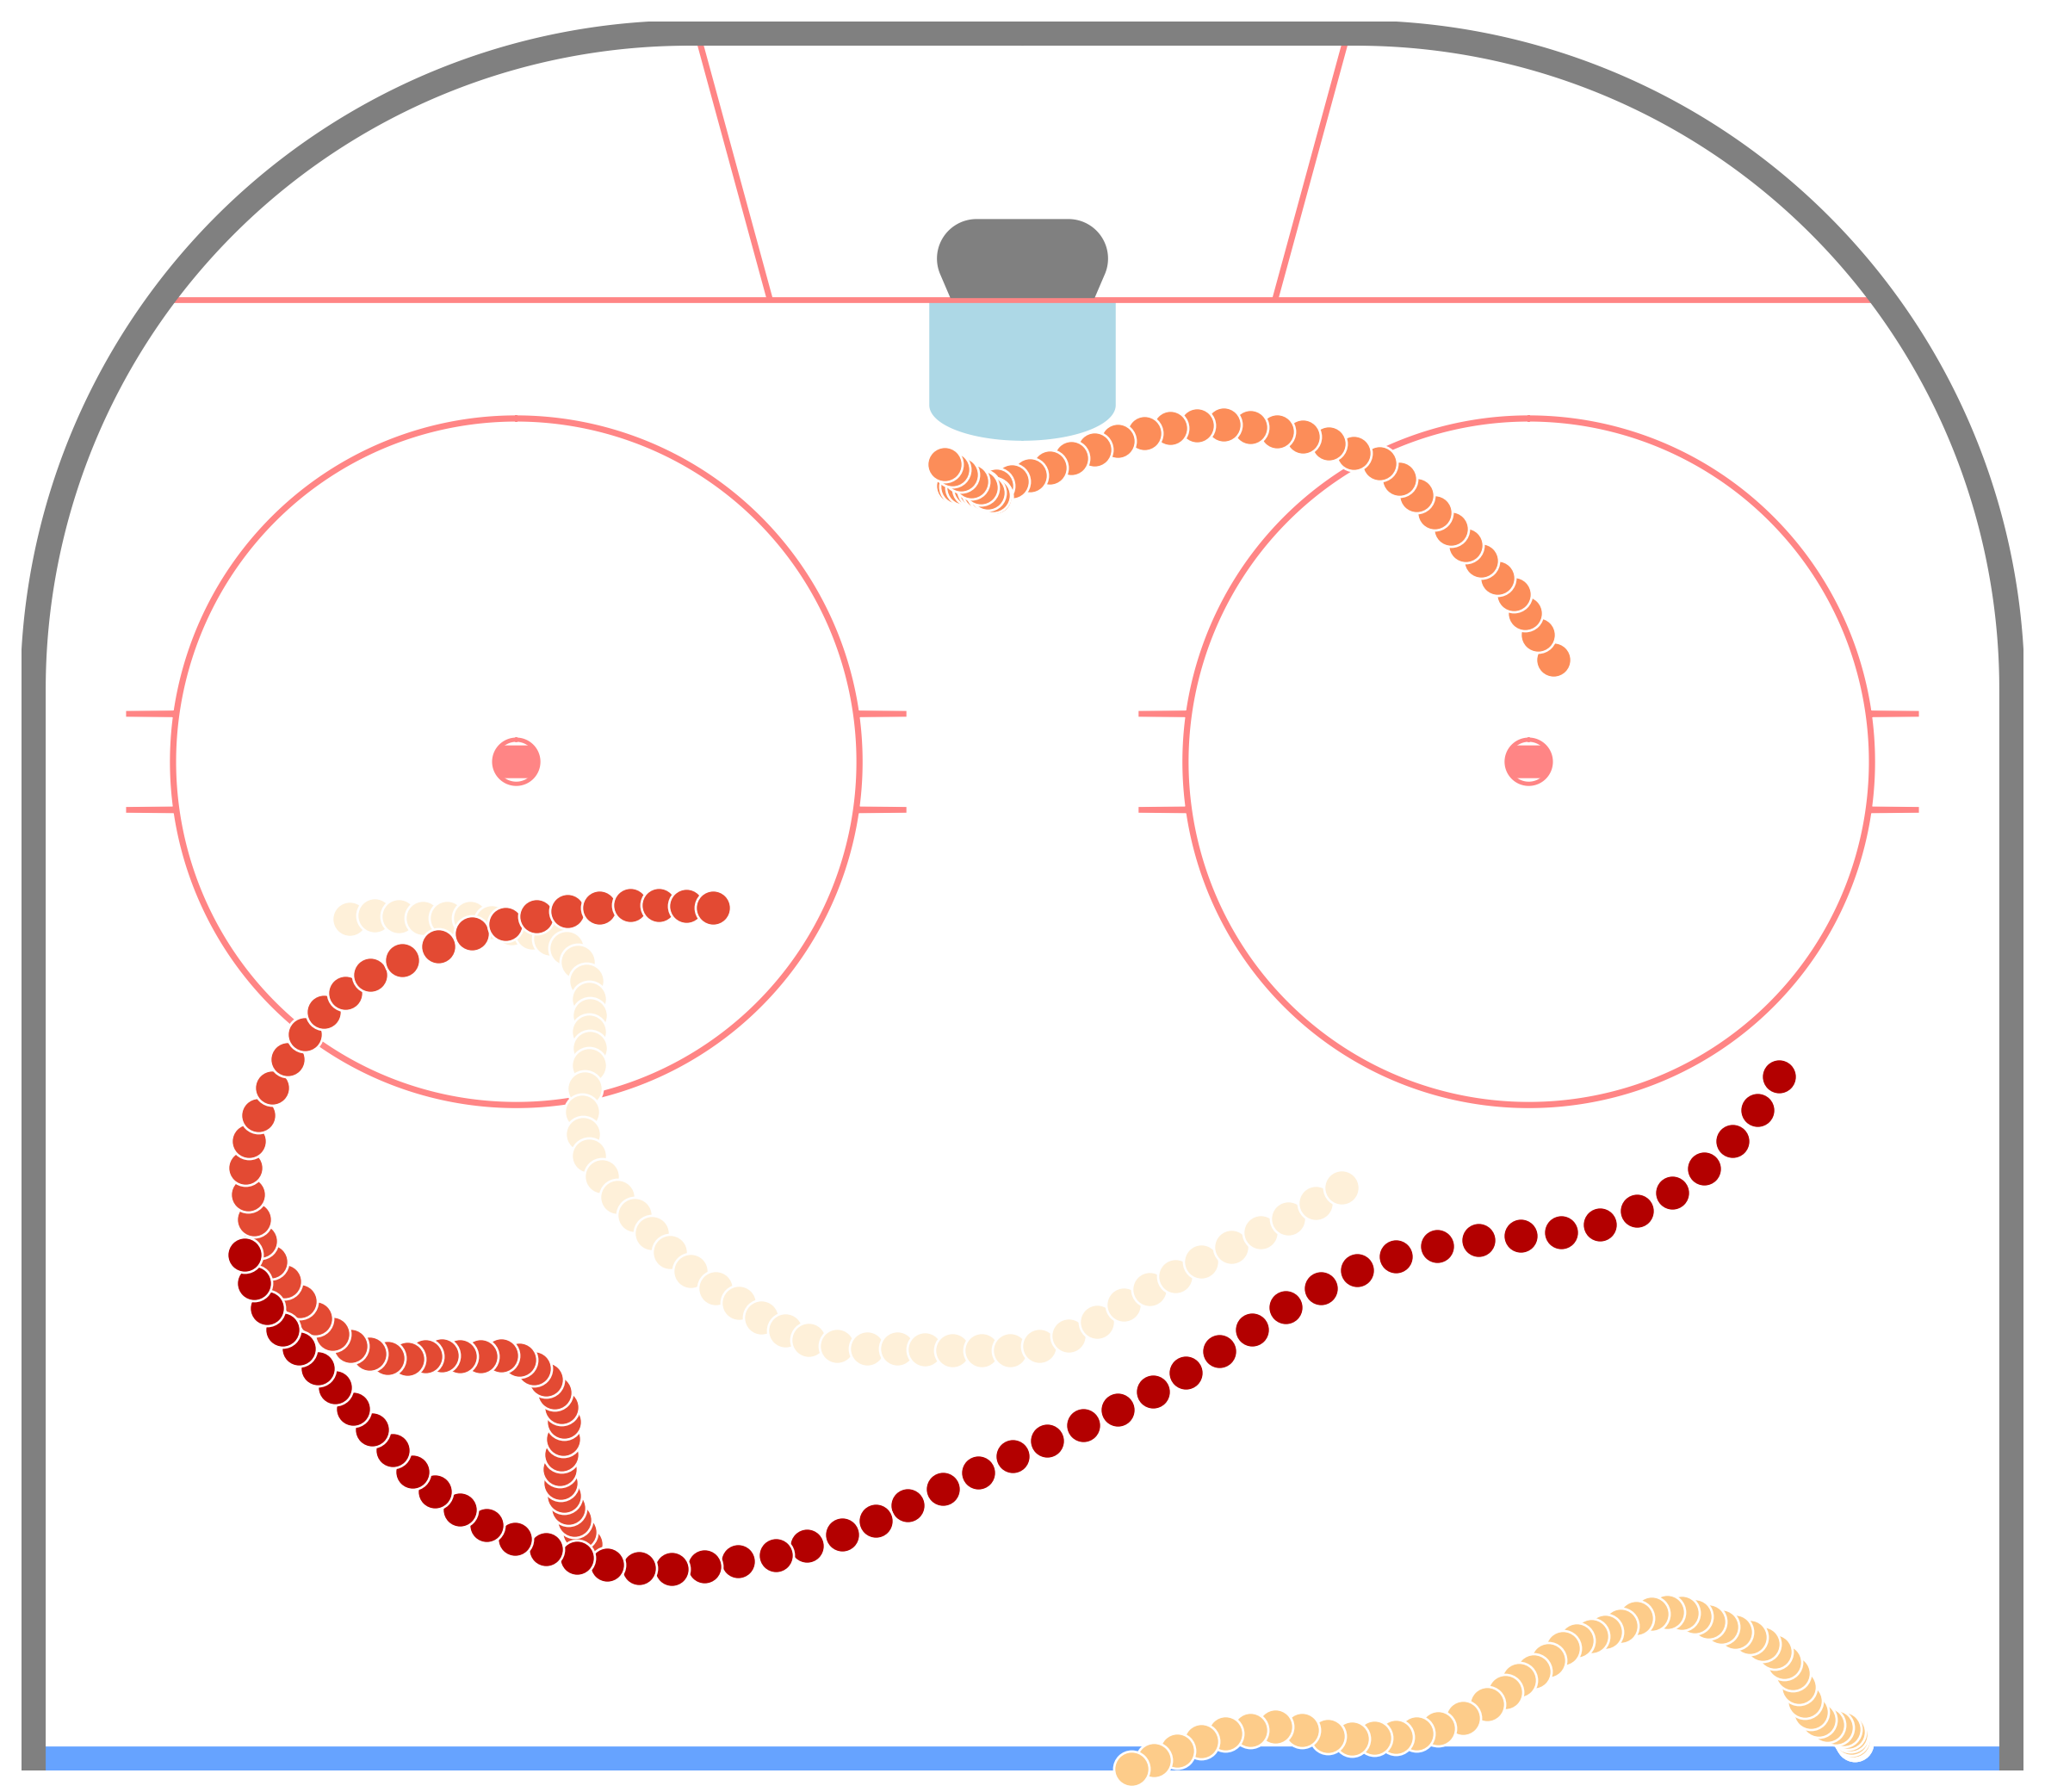
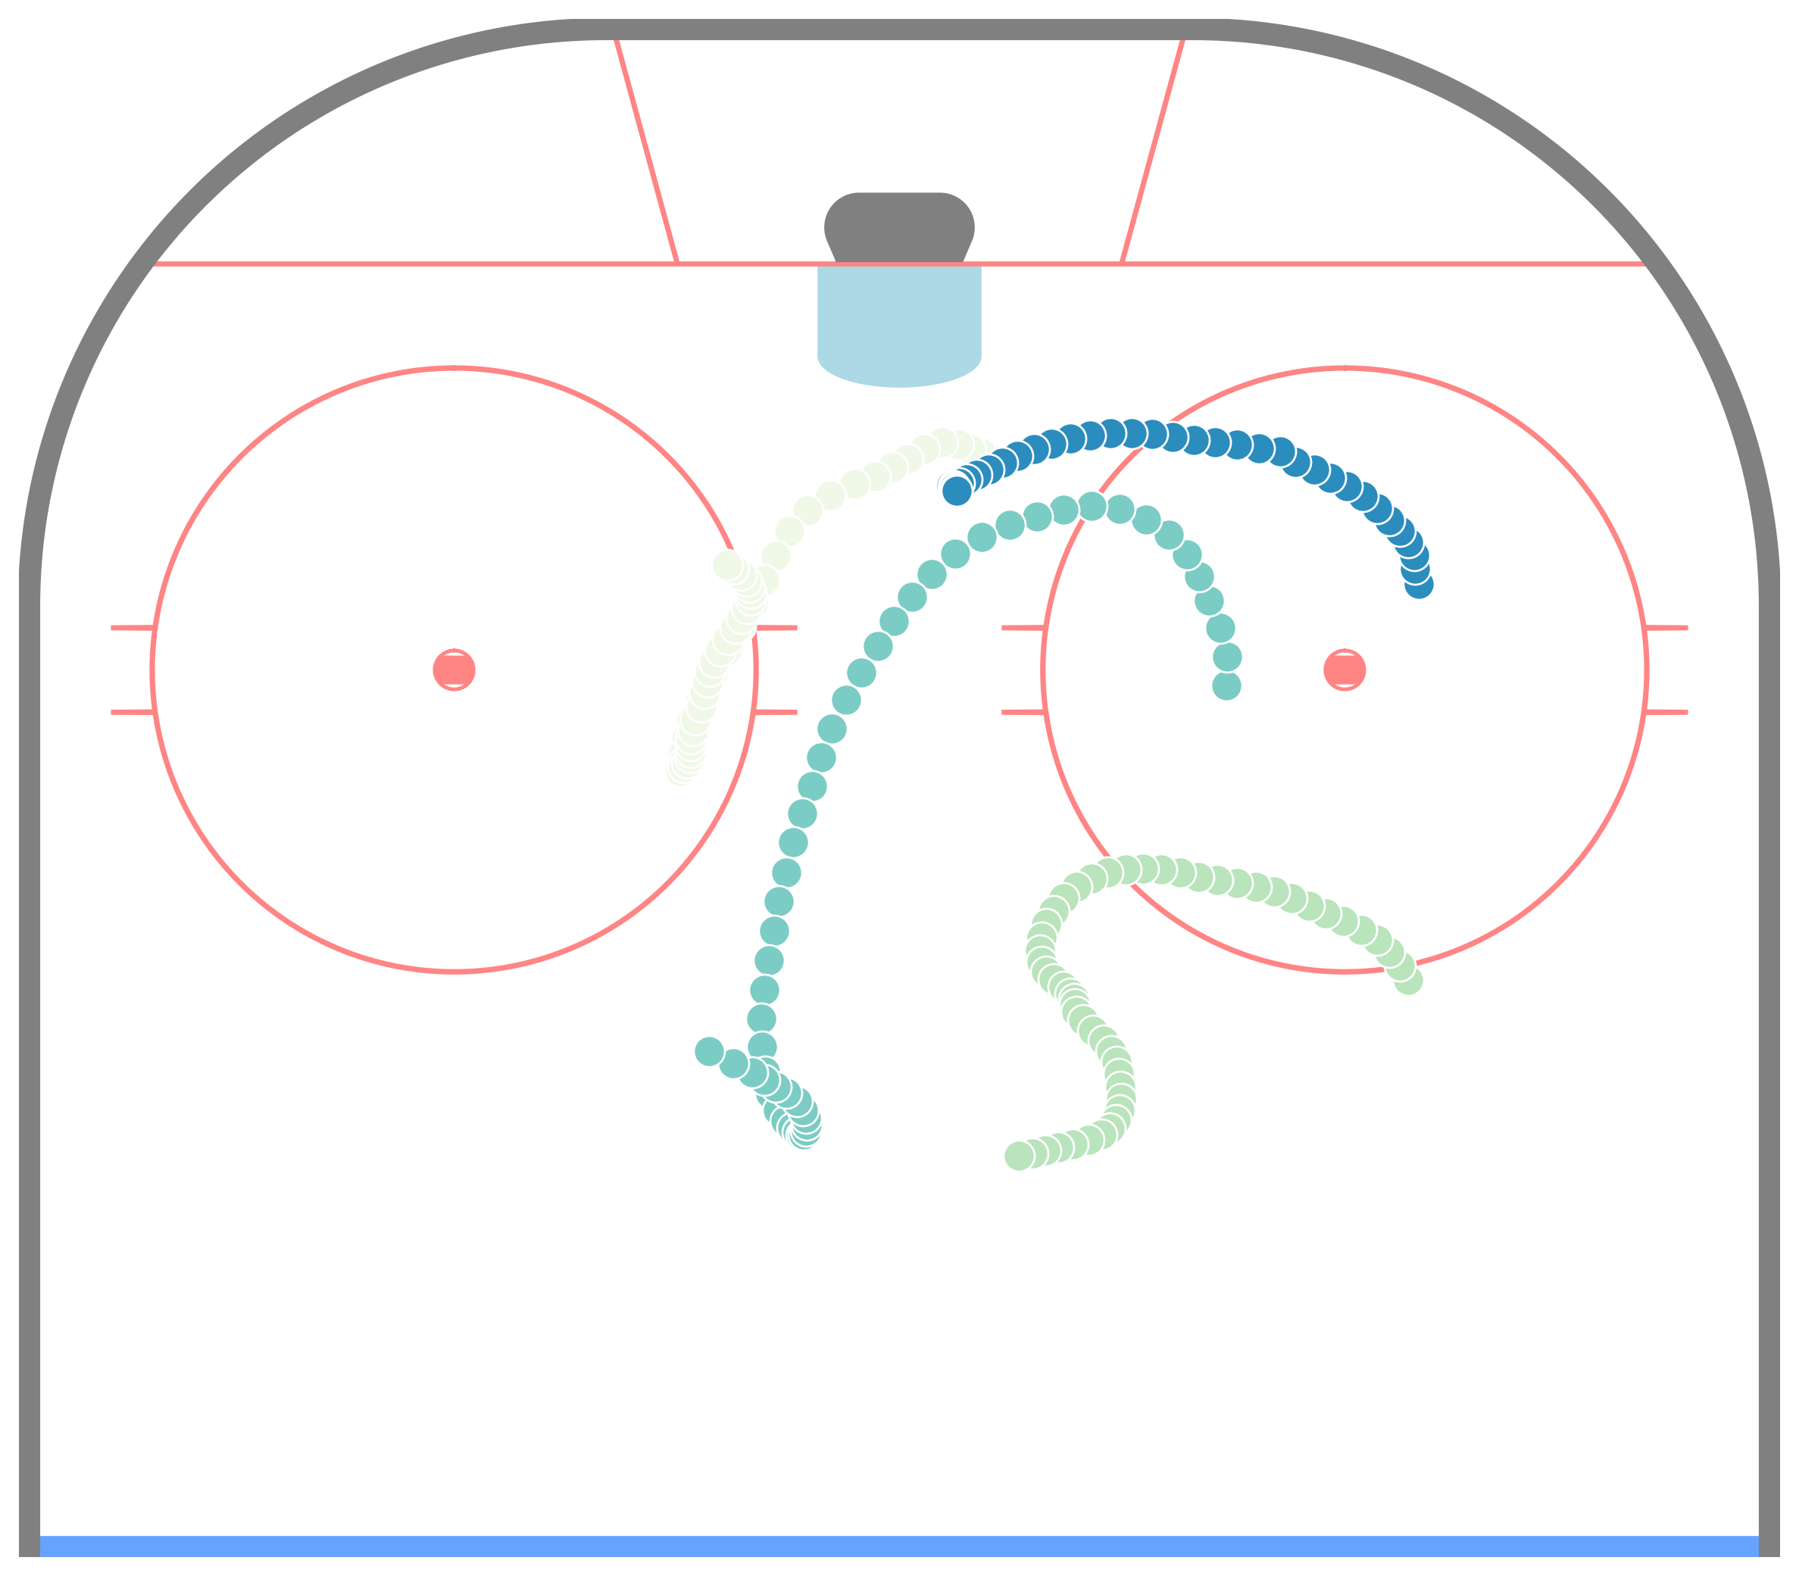
Example Possessions
Power Play
Penalty Kill
Extended possession – teams have time to organize and maintain desired positioning
Short possessions – minimal organization due to lack of time
Notes:
Some possessions are long enough that teams have time to organize themselves into tactical formations. Similarly, some possessions are shorter, and there is minimal organization. To focus more on the longer type of possession, we add additional restrictions to our definition of possessions.

Slide 12
Roles and Formations
Our approach
Identify sequences when the power play is in formation.
Define roles from data using non-negative matrix factorization.
Assign each player a unique role at each time point by solving a linear assignment problem.
Cluster roles together to facilitate the analysis of player deployment.

Slide 13



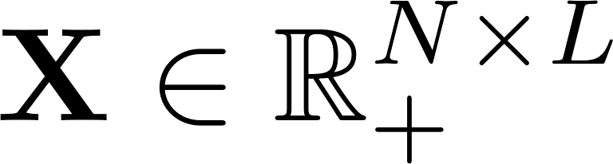
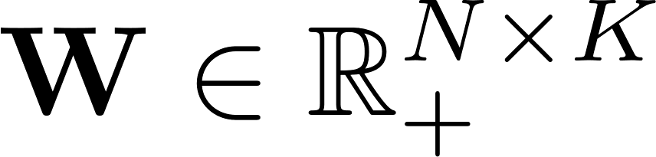
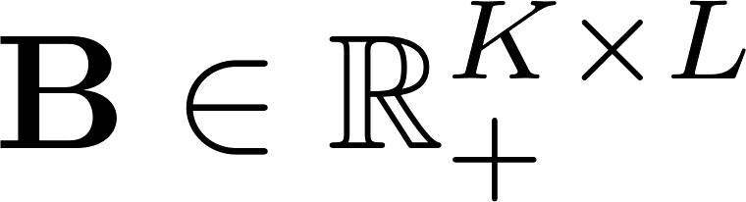


Defining Roles
Non-Negative Matrix Factorization
Factorize a non-negative matrix into the product of two non-negative matrices.
A weight matrix
A basis matrix
Each row of is approximated as a weighted sum of the bases.

Slide 14
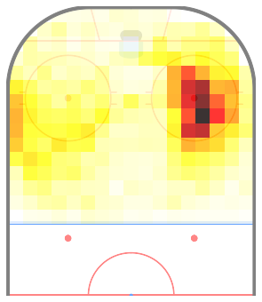
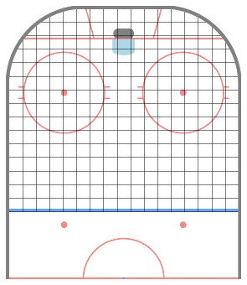


Defining Roles
Creating the count matrix
Discretize the offensive zone into 5ft by 5ft bins.
249 bins
For each player, an individual count matrix is generated [1].
Omit players with less than 180s worth of data.
For the PP, 417 players.
For the PK, 419 players.
[1] A. Miller, L. Bornn, R. Adams, and K. Goldsberry, “Factorized Point Process Intensities: A Spatial Analysis of Professional Basketball,” in Proc. 31st Inter. Conf. on Machine Learning, 2014, pp. 398–414.
Notes:
To create this matrix we want to decompose, we omit players with less than 180s worth of data. At 5v4, this leads to 417 players and at 4v5 419 players. We discretize the ice into 5 by 5 ft bins. This means we have 249 bins. Each individual count matrix is normalized to have unit sum, and is denoised using a Gaussian blur to reduce the effect of sample size and the arbitrary binning of the ice.

Slide 15
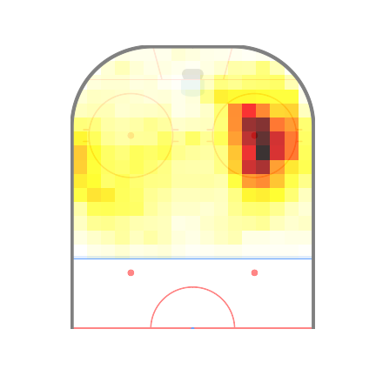
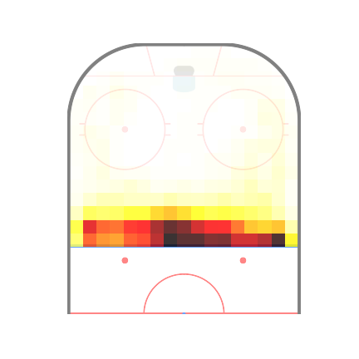

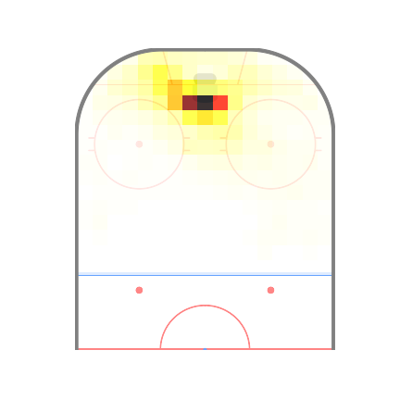

Defining Roles
Creating the count matrix
The individual count matrices are flattened and stacked to obtain .
Player 1
Locations
Player
Players
Player
Notes:
The individual count matrices are flattened and stacked to obtain X. Each column of X represents a location on the ice, and each row of X represents a player.

Slide 16
Defining Roles
Interpreting the results of the factorization
Basis Matrix
Weight Matrix
Bases
Players
Locations
Bases
Spatial role definitions
Contribution of each role to a player’s count matrix
Notes:
Factorizing X using NMF yields two matrices. The basis matrix contains the role definitions. Each row corresponds to a role, and each column corresponds to a location. The weight matrix contains information about the amount of time each player spends in each basis.

Slide 17
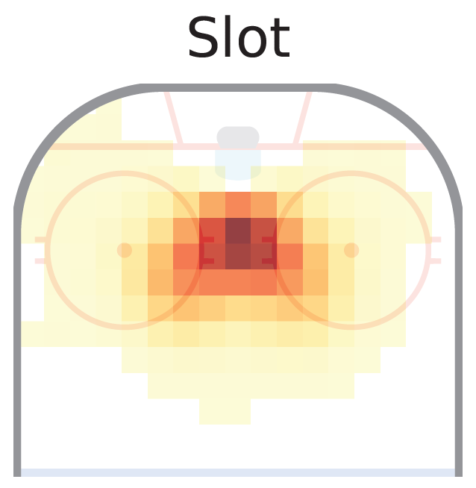
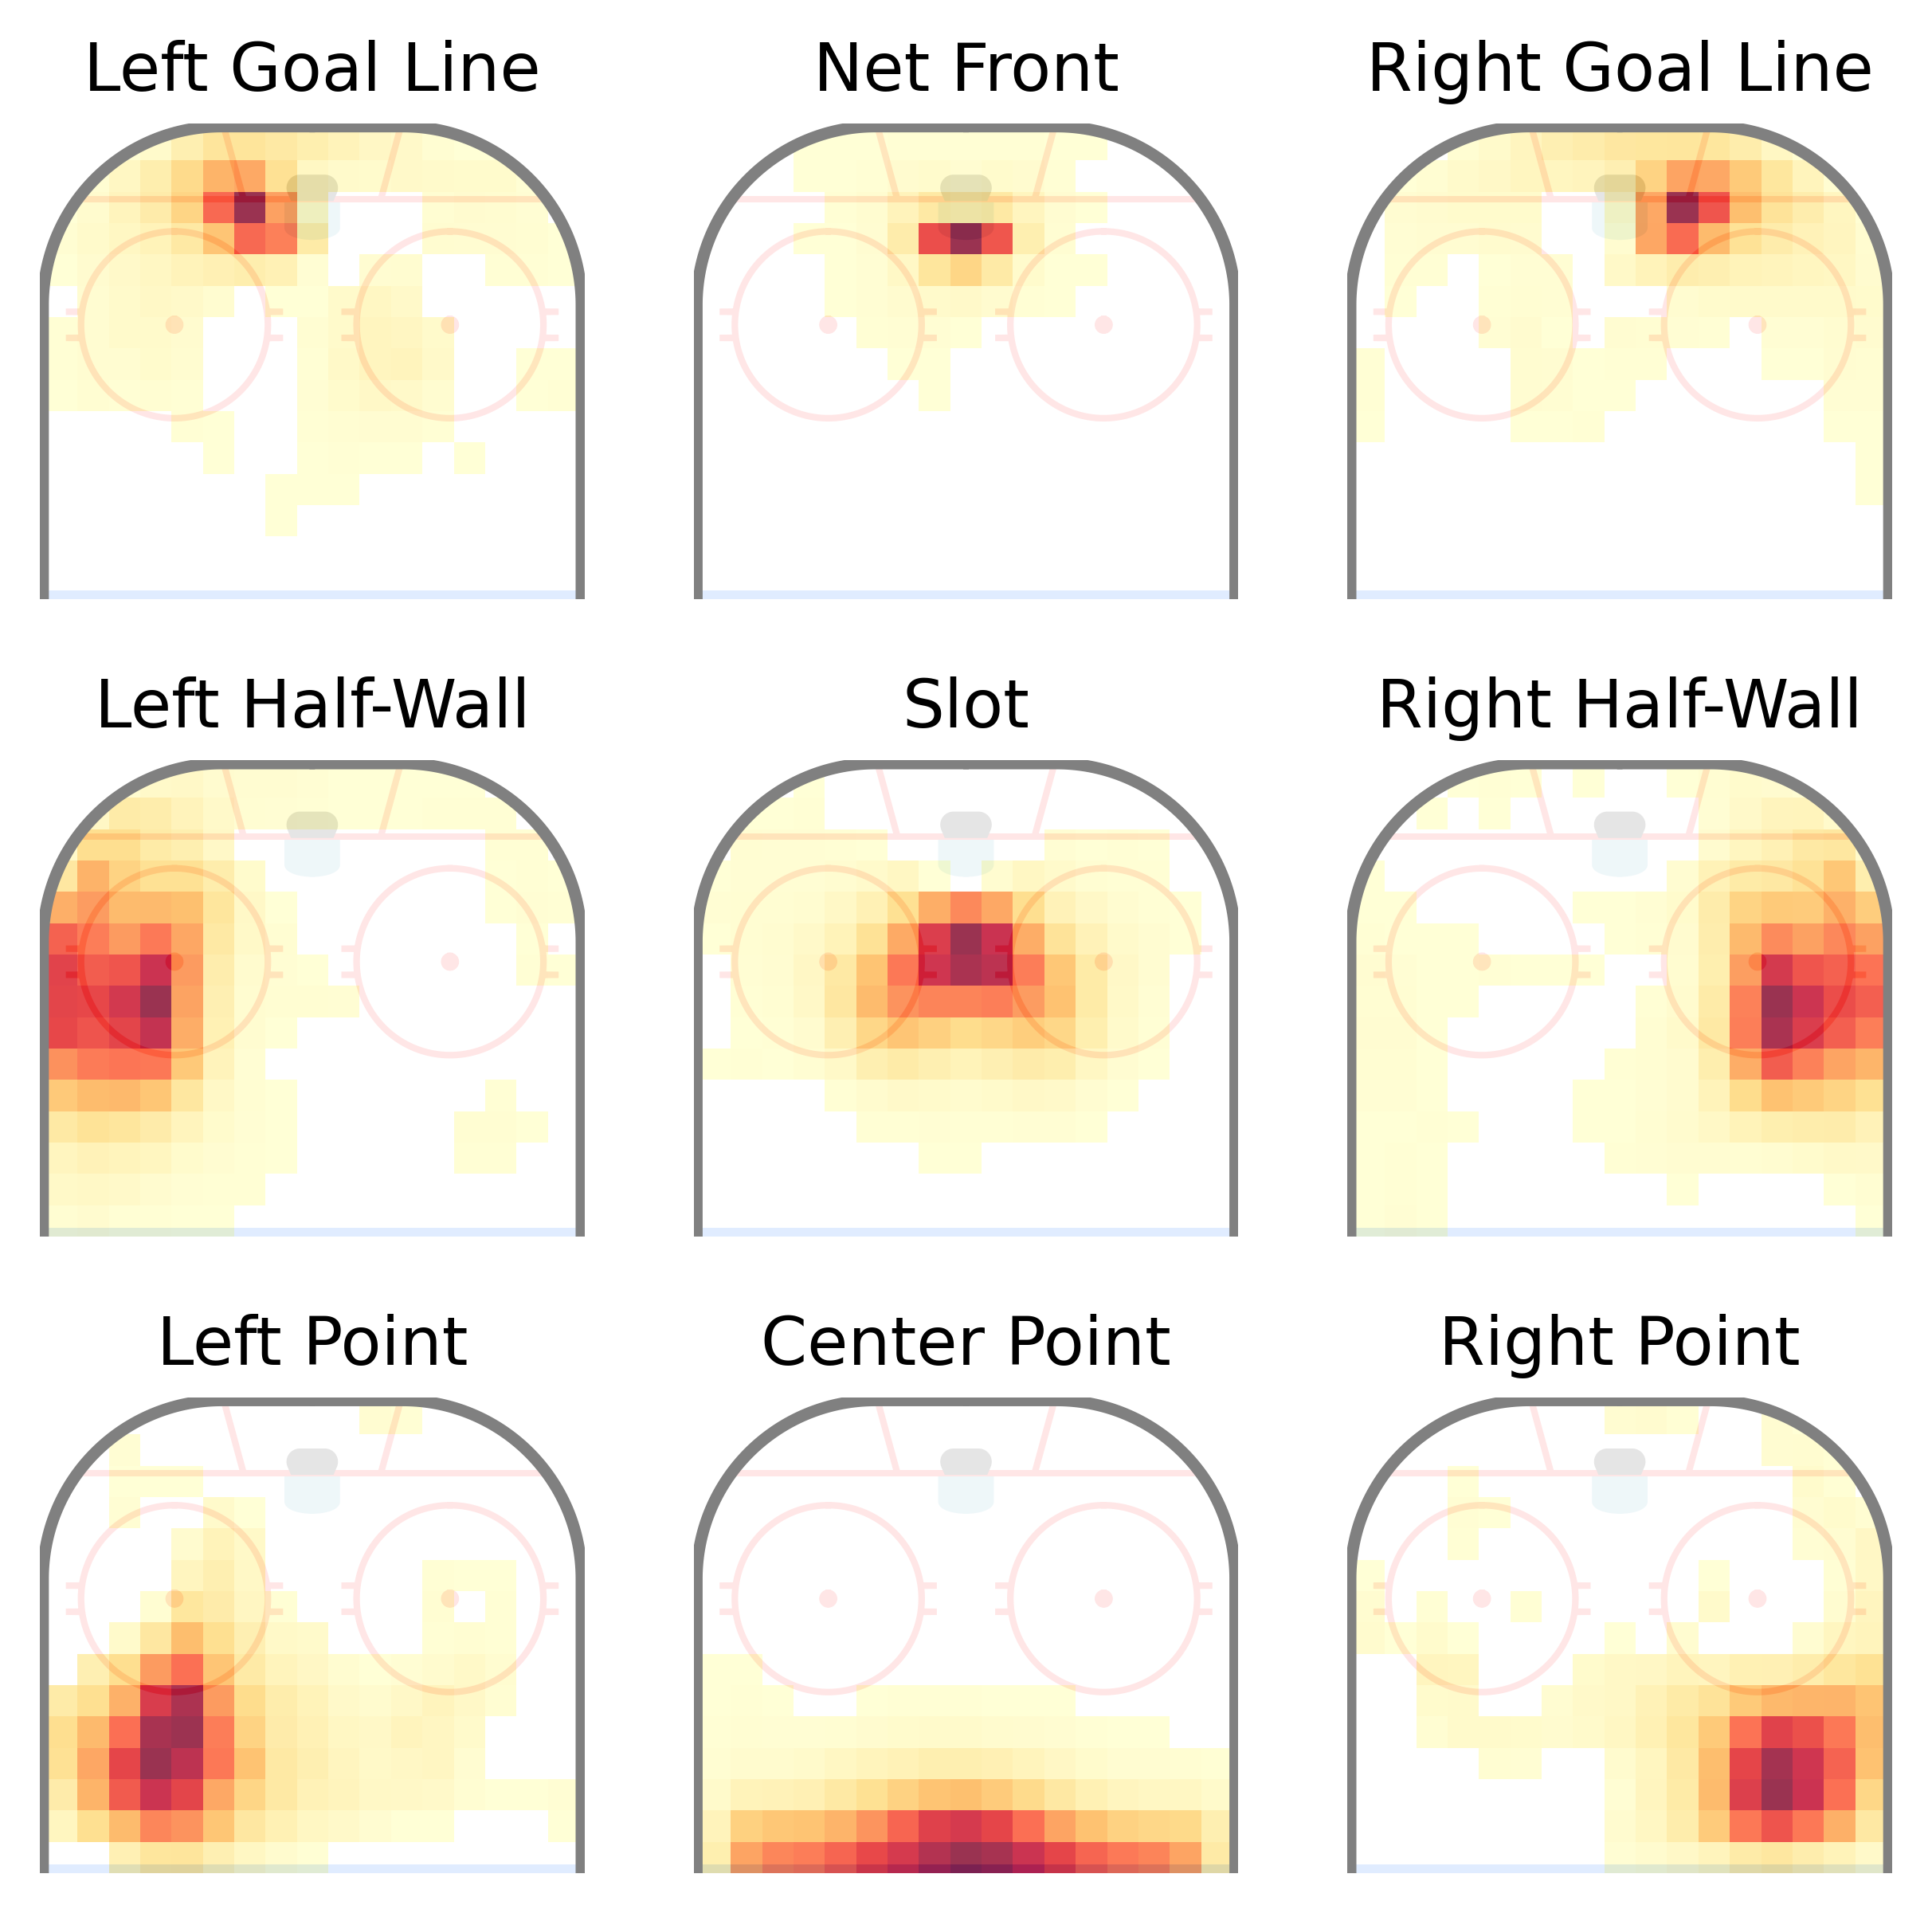
Power Play Roles
Notes:
The role definitions from NMF for the power play look like this. We chose 9 roles as it led to meaningful role definitions. We can zoom in on the Slot role, for example.

Slide 18
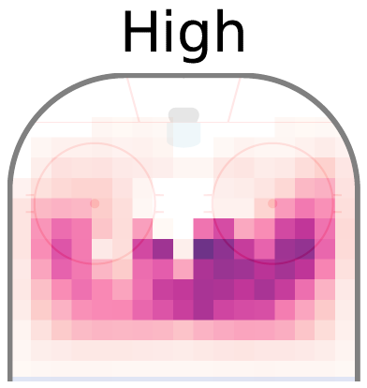
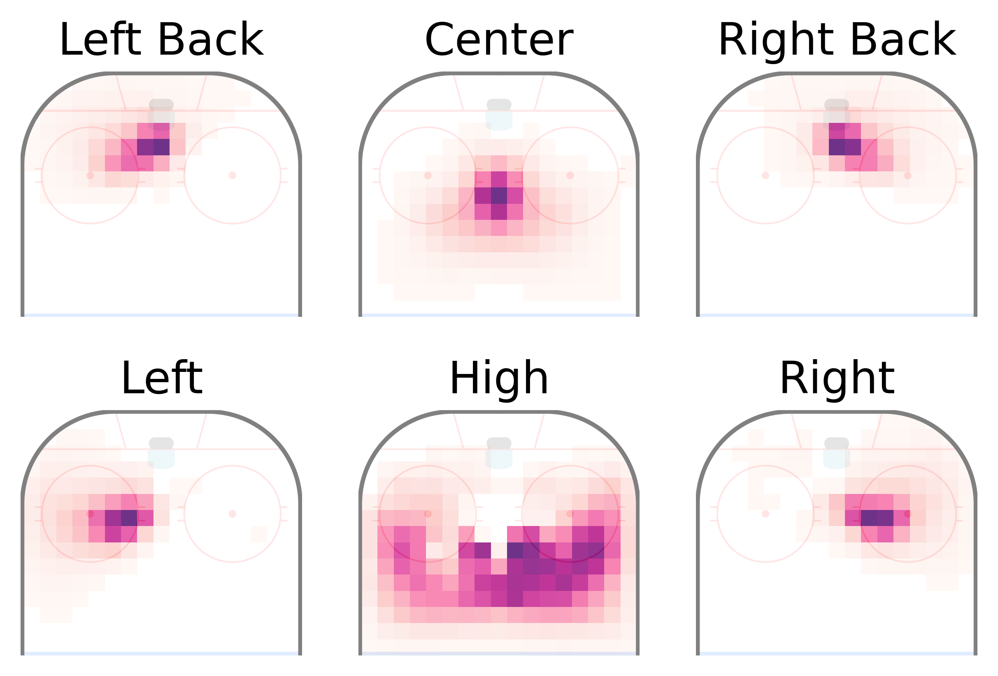
Penalty Kill Roles
Notes:
On the penalty kill, we chose 6 roles. There are two roles for the back, one for the left and one for the right. One role is more central, and one role definition arose for players playing high in the zone.

Slide 19
Roles and Formations
Our approach
Identify sequences when the power play is in formation.
Define roles from data using non-negative matrix factorization.
Assign each player a unique role at each time point by solving a linear assignment problem.
Cluster roles together to facilitate the analysis of player deployment.

Slide 20
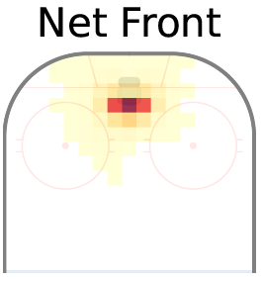
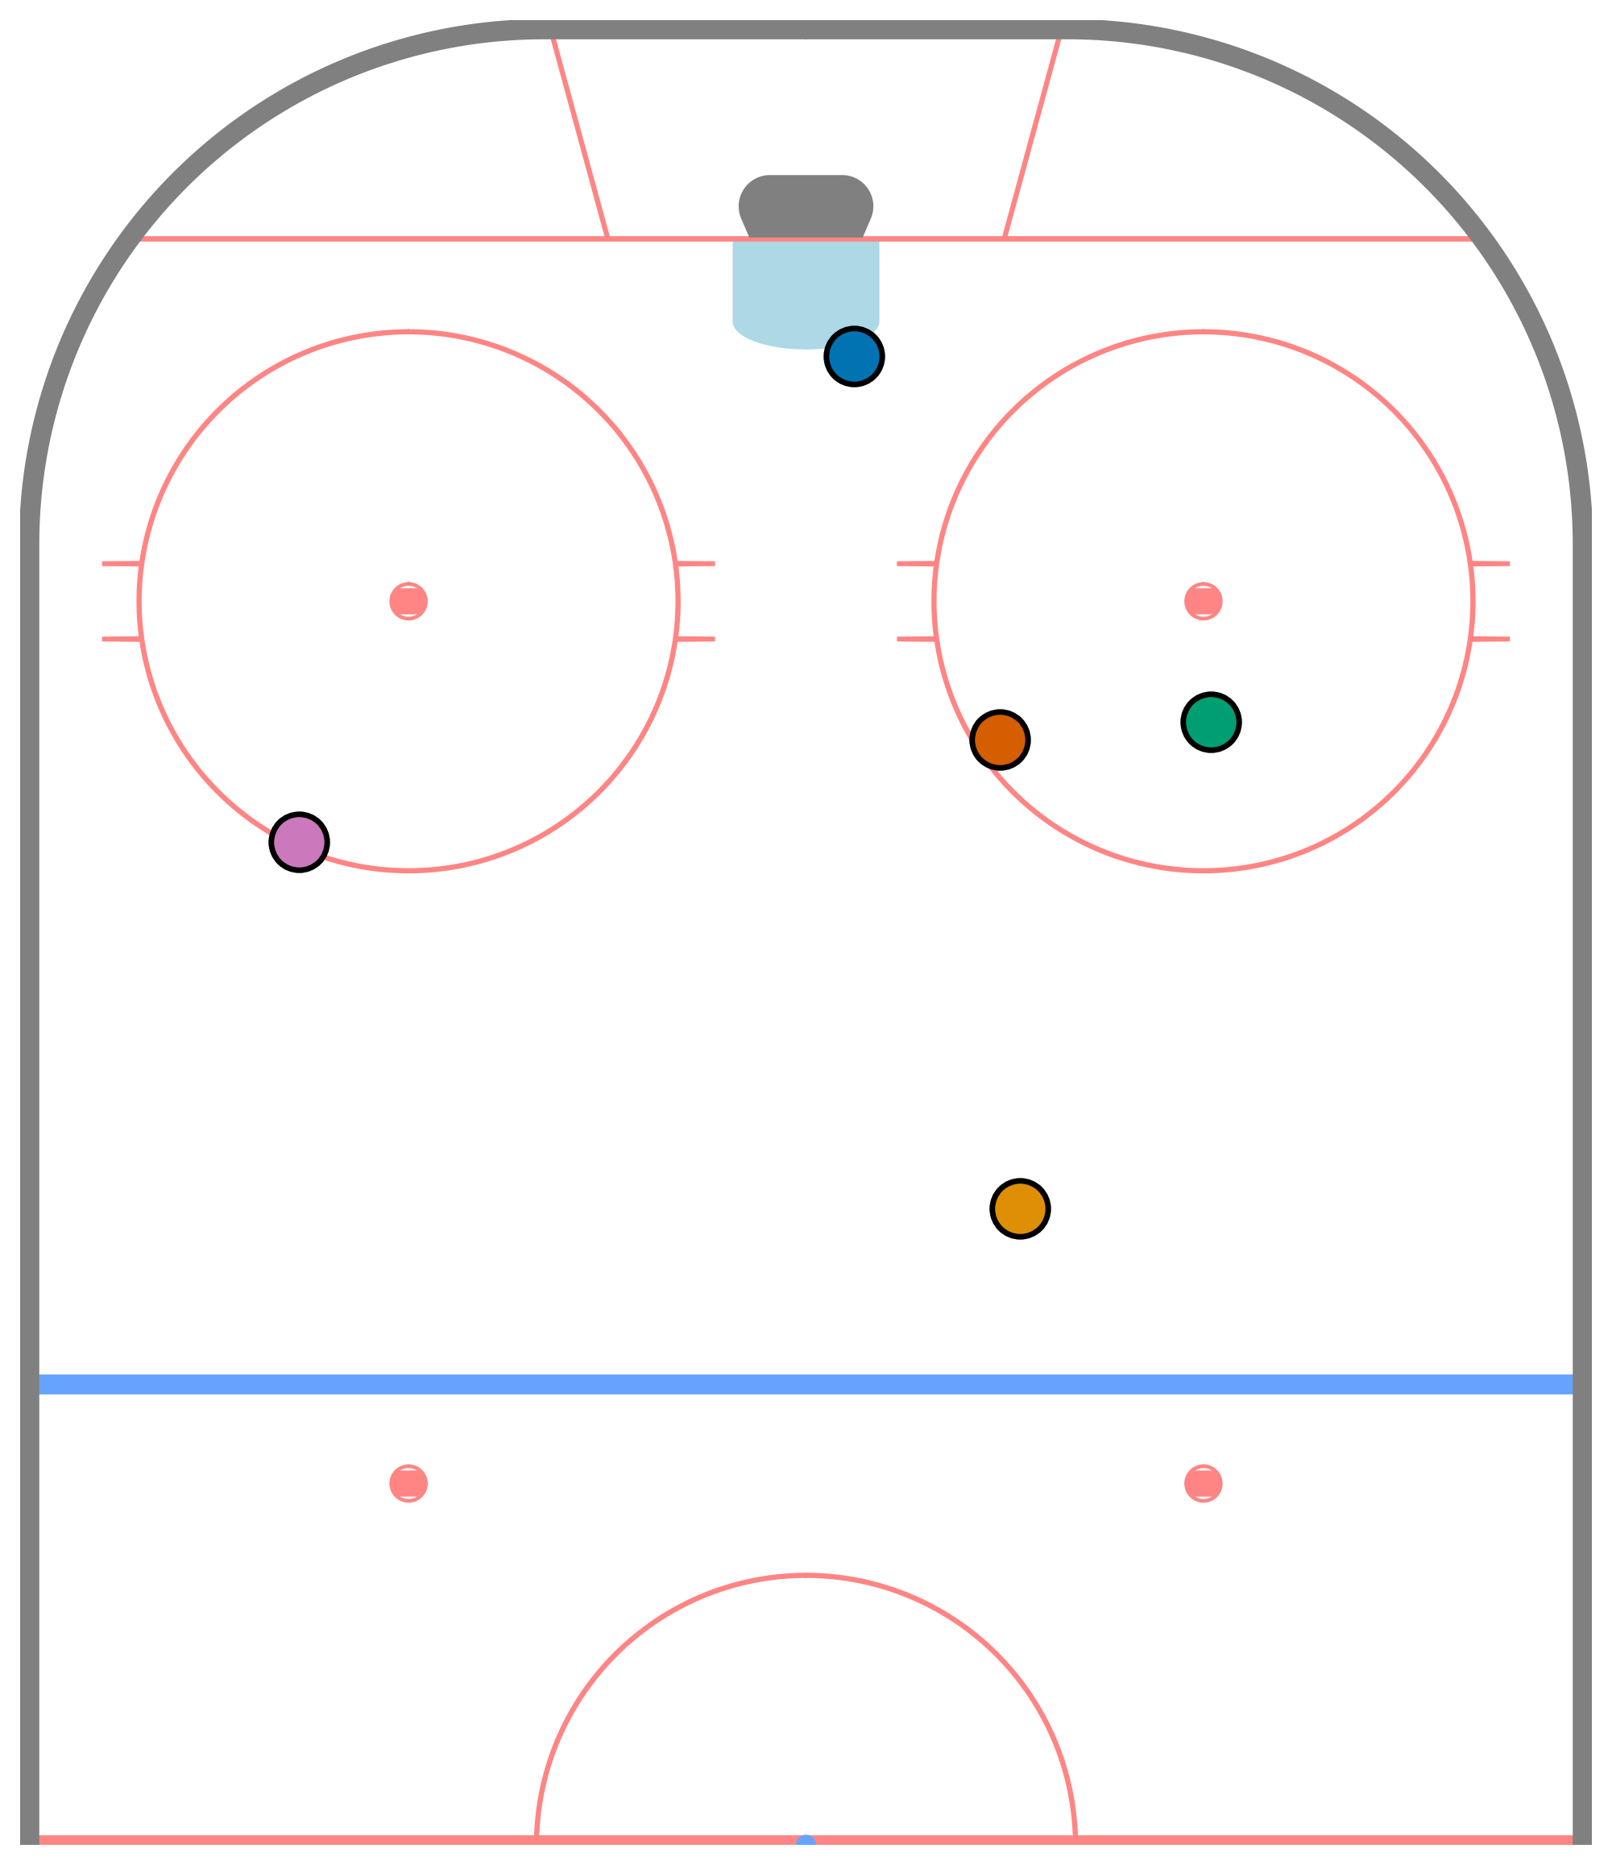
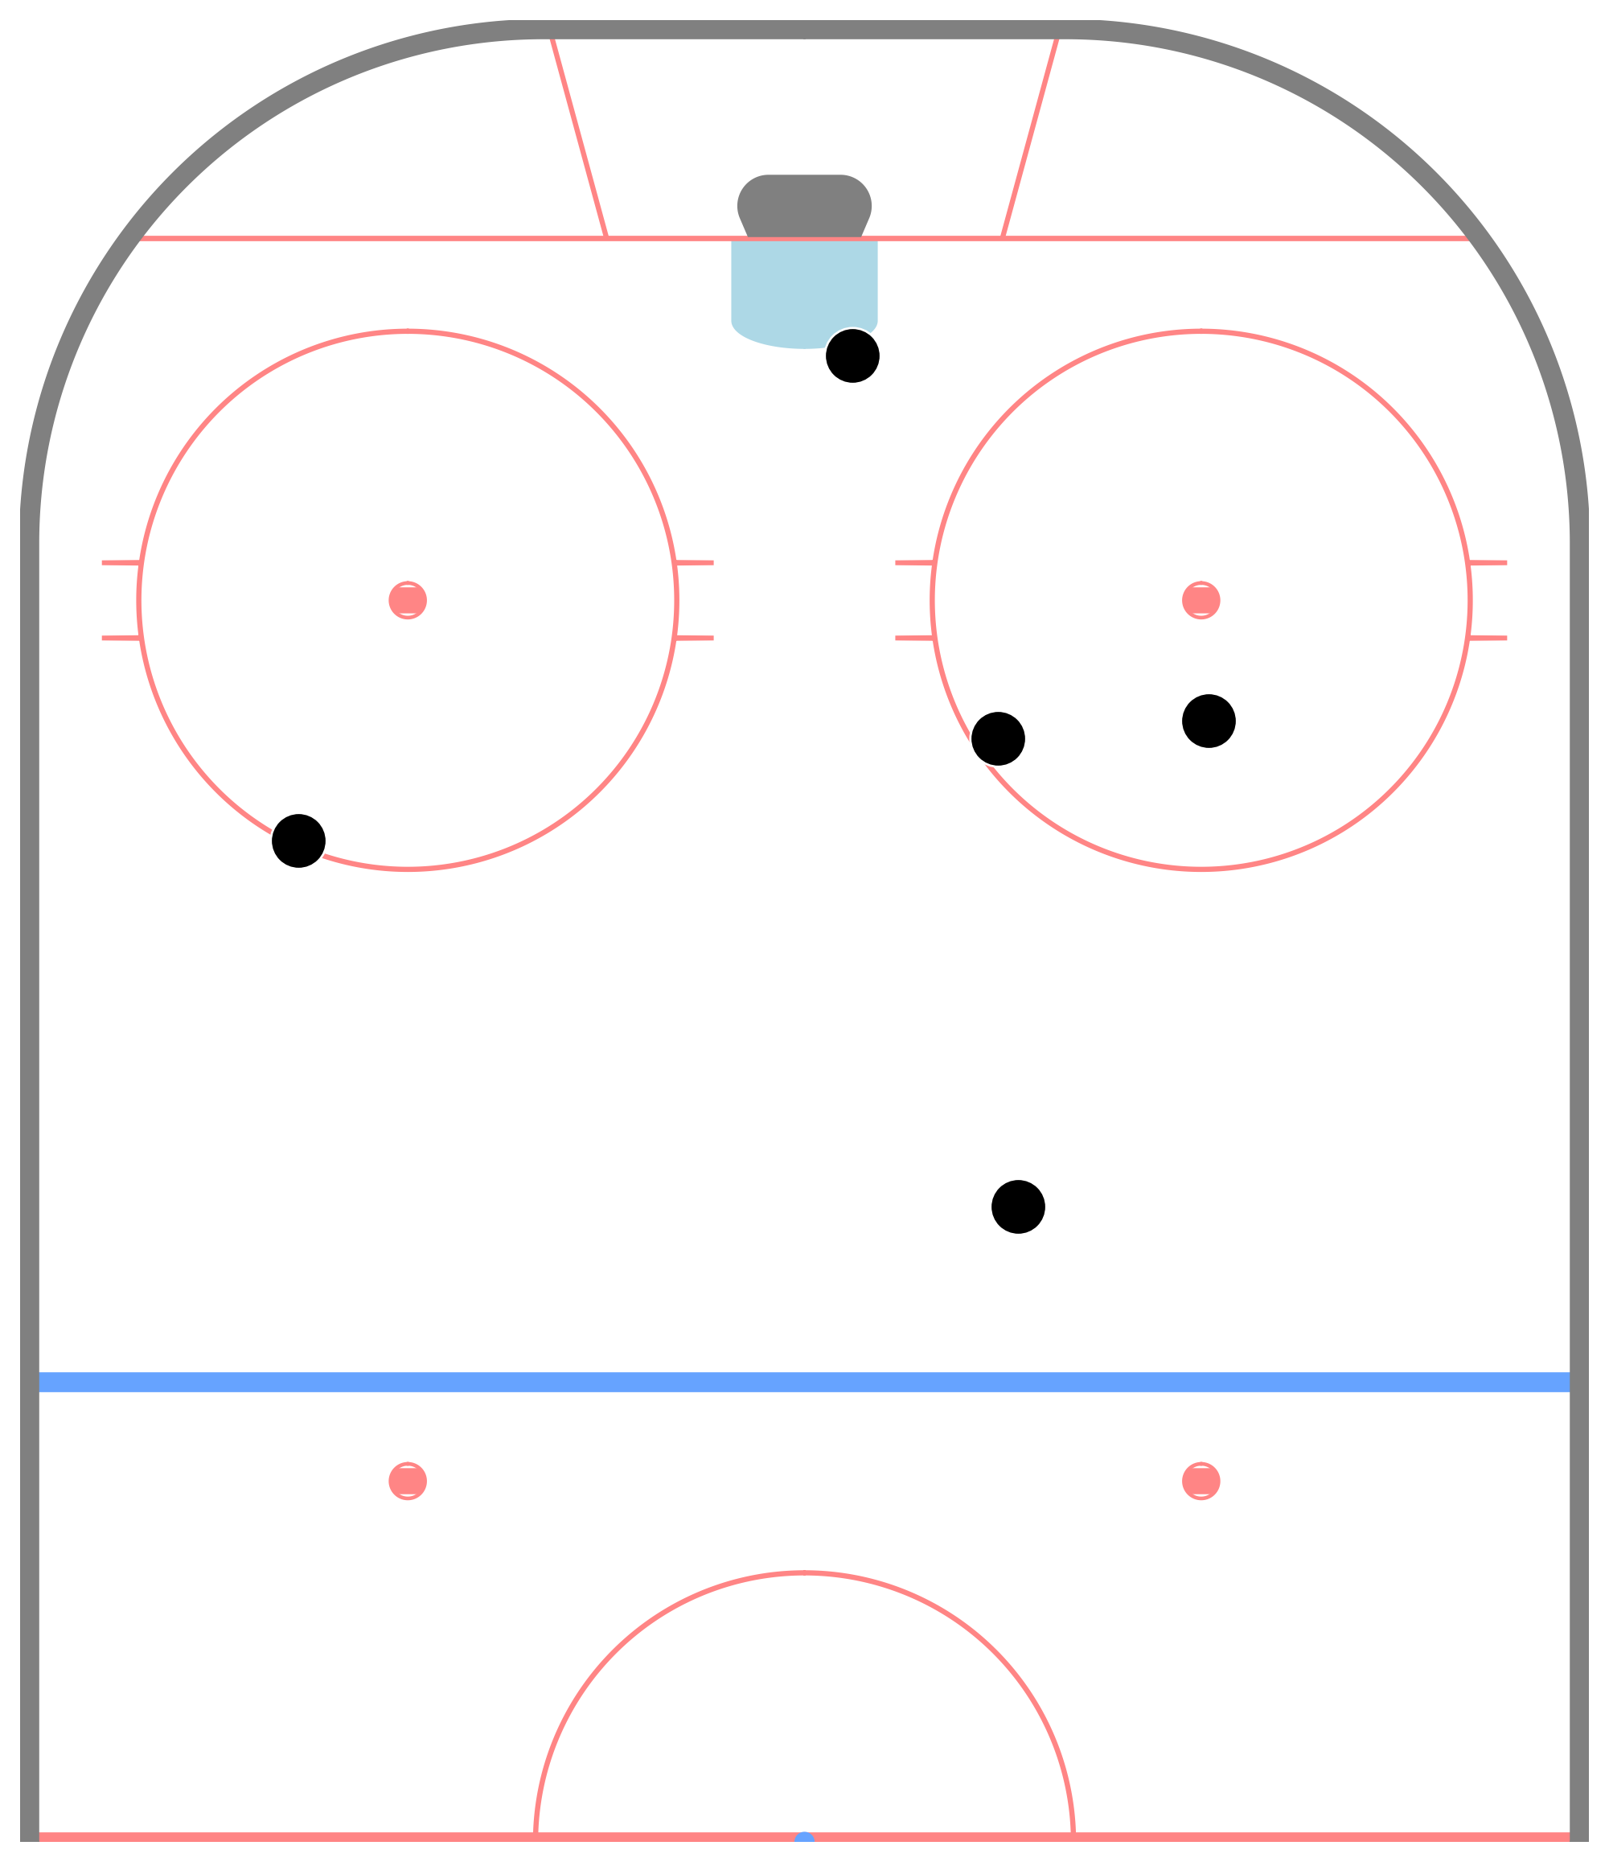
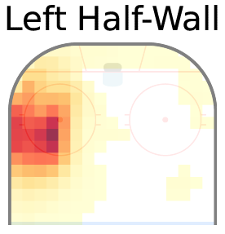
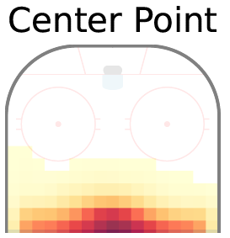
Uniquely Allocating Roles
Linear assignment problem is formulated by determining the cost of allocating a role to a player [1, 2].
The cost is computed using
the location of the player,
how frequently the player was observed in each role.
These quantities are available from the basis and weight matrices.
[1] P. Lucey, A. Bialkowski, P. Carr, S. Morgan, I. Matthews, and Y. Sheikh, “Representing and Discovering Adversarial Team Behaviors Using Player Roles,” in Proc. 2013 IEEE Conf. on Computer Vision and Pattern Recognition (CVPR), 2013, pp. 2706–2713.
[2] H. W. Kuhn, “The Hungarian Method for the Assignment Problem,” Naval Research Logistics Quaterly, vol. 2, no. 1–2, pp. 83–97, 1955.

Slide 21
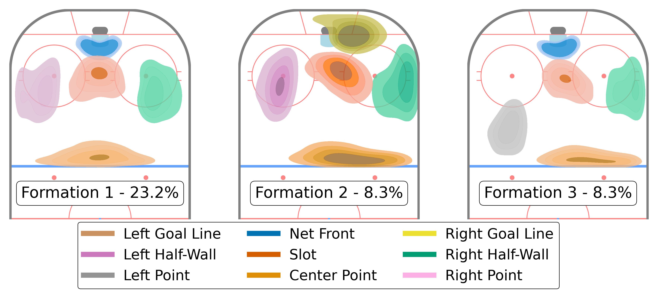
Power Play Formations
Most observed formations
Notes:
Spatially, what do these formations look like. There, we have the three most frequently observed power play formations. Formation 1 is what I’d call the base formation, observed nearly one quarter of the time. There is one player playing the point, one on the left and right, one in the slot and one playing the net front. The two other formations shown here are slight variations on the base formation.

Slide 22
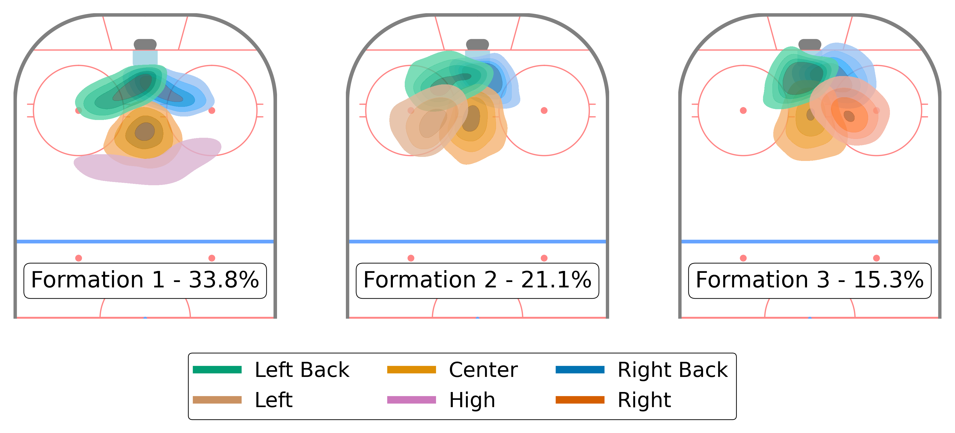
Penalty Kill Formations
Most observed formations
Notes:
On the penalty kill, formation 1 is once again something of a base formation, observed 33% of the time. The other two formations simply swap out the player playing the high role for a player playing the left or the right.

Slide 23
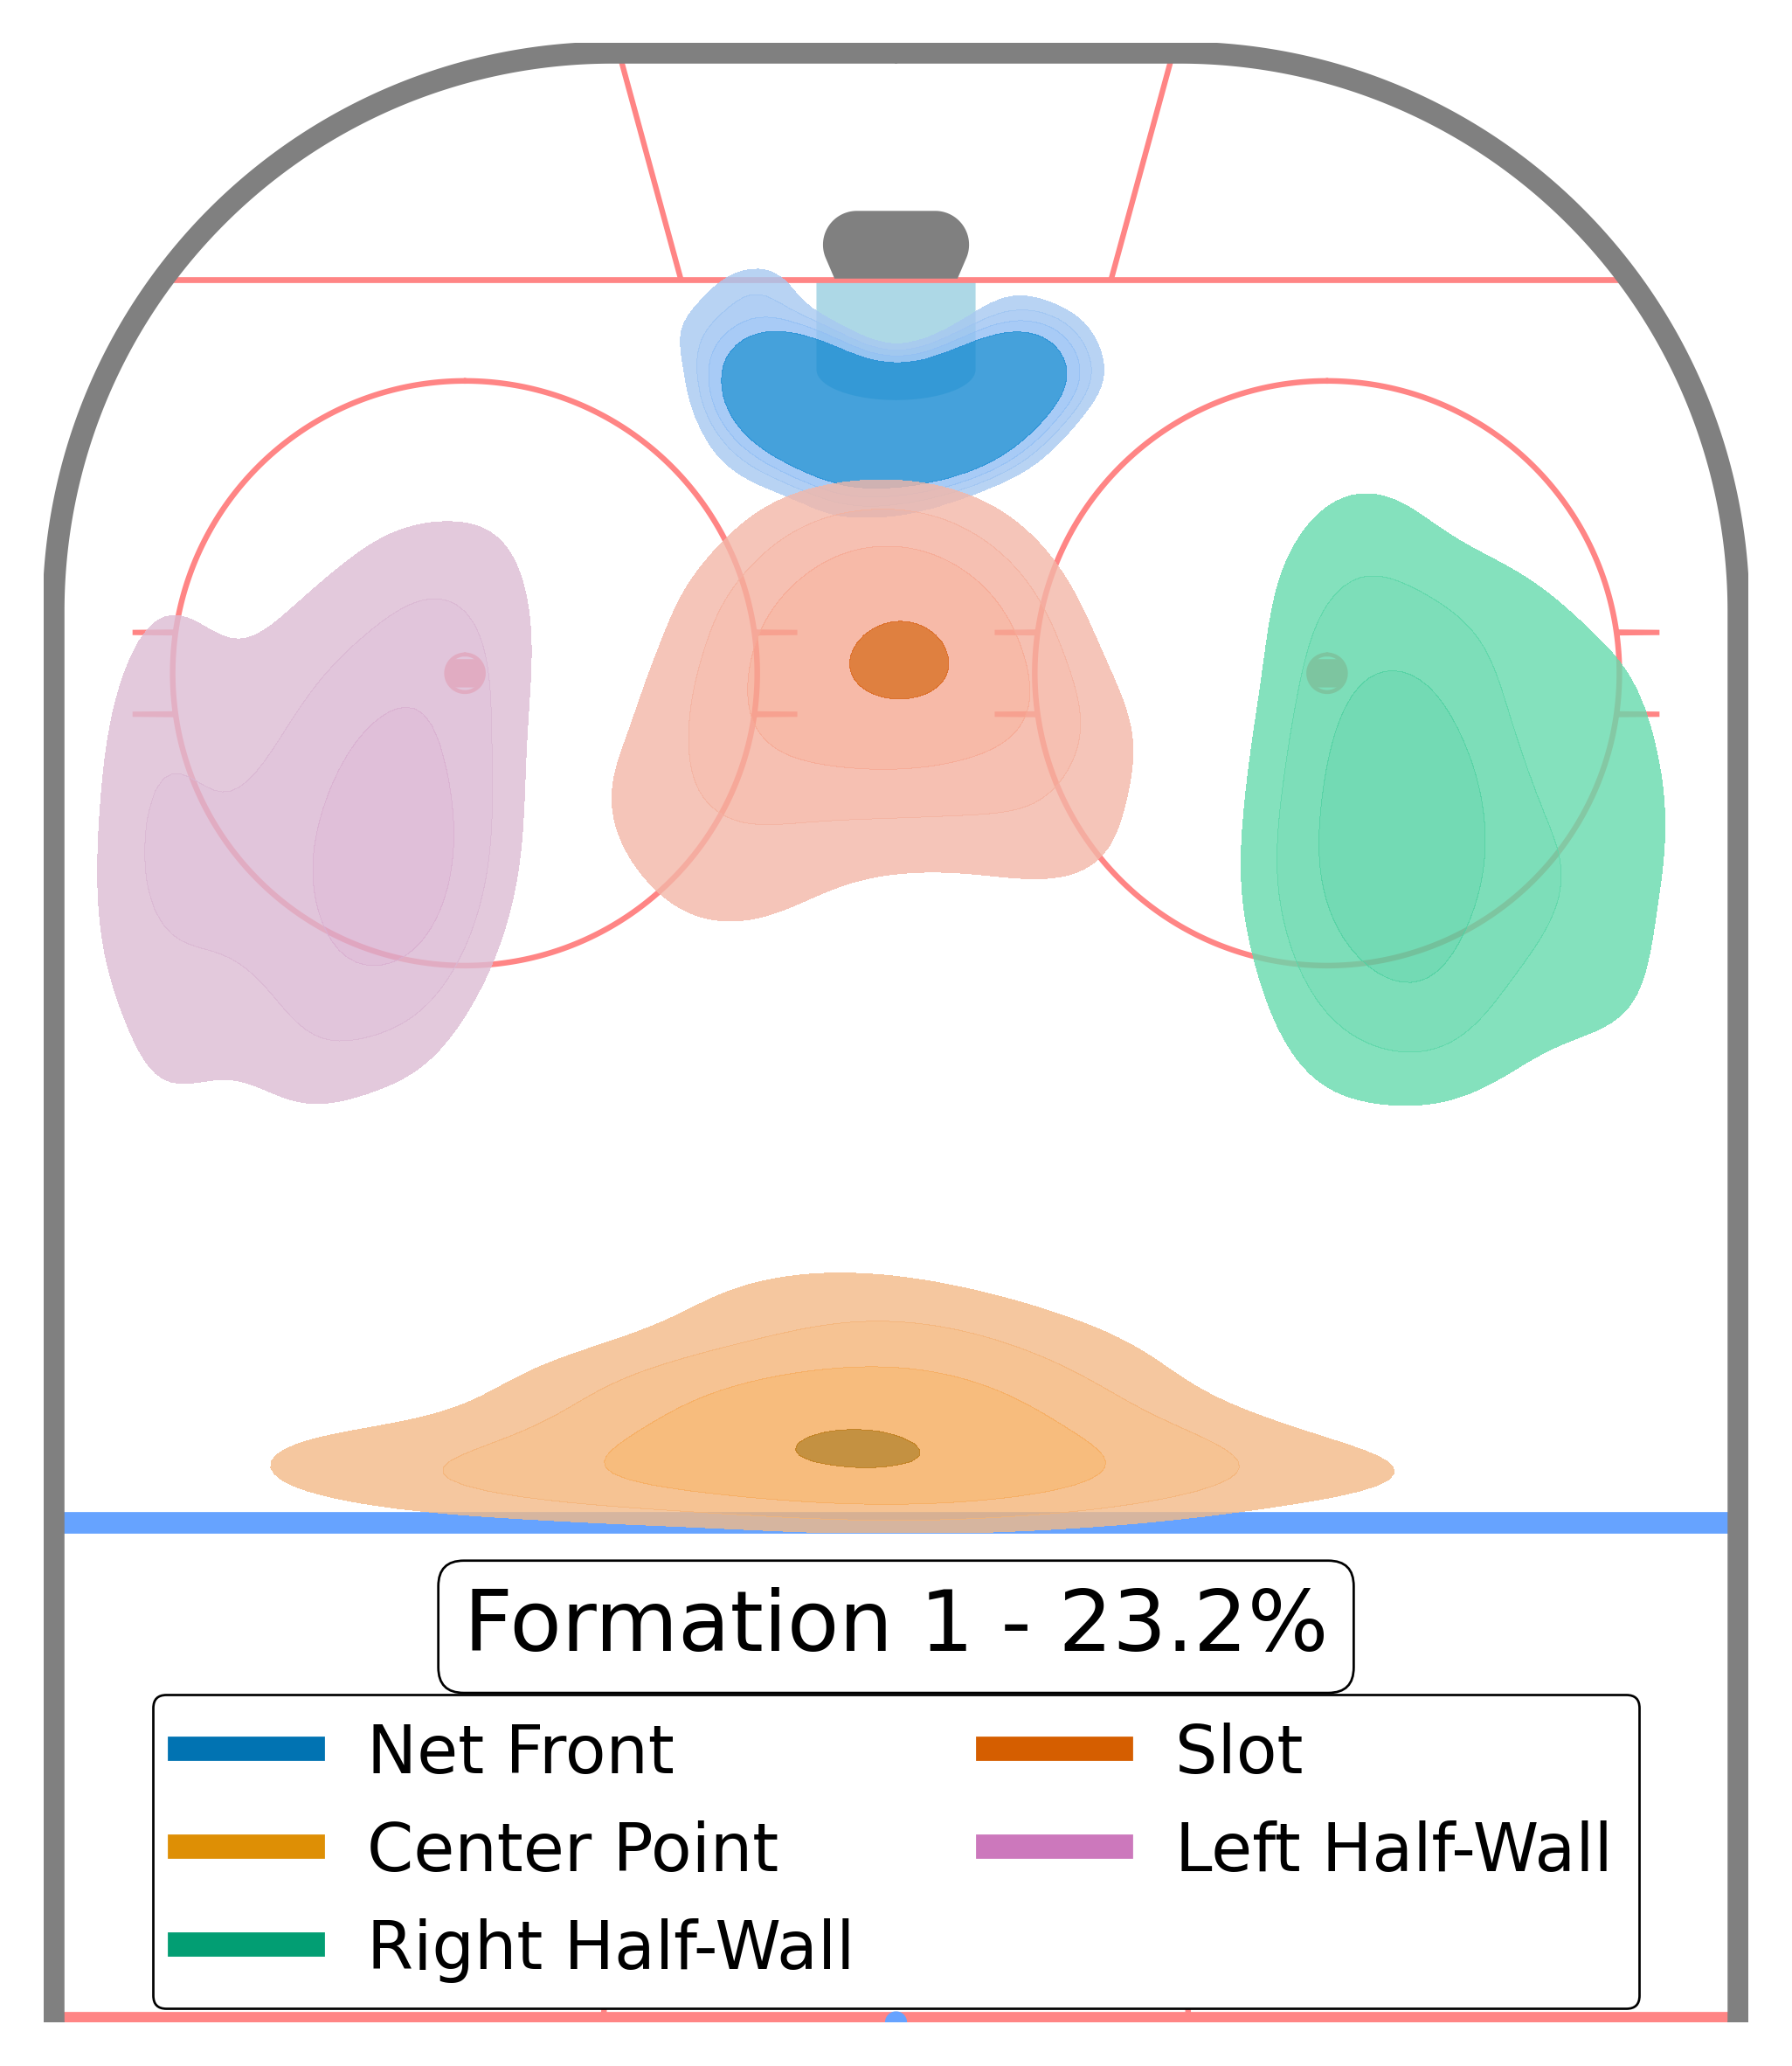
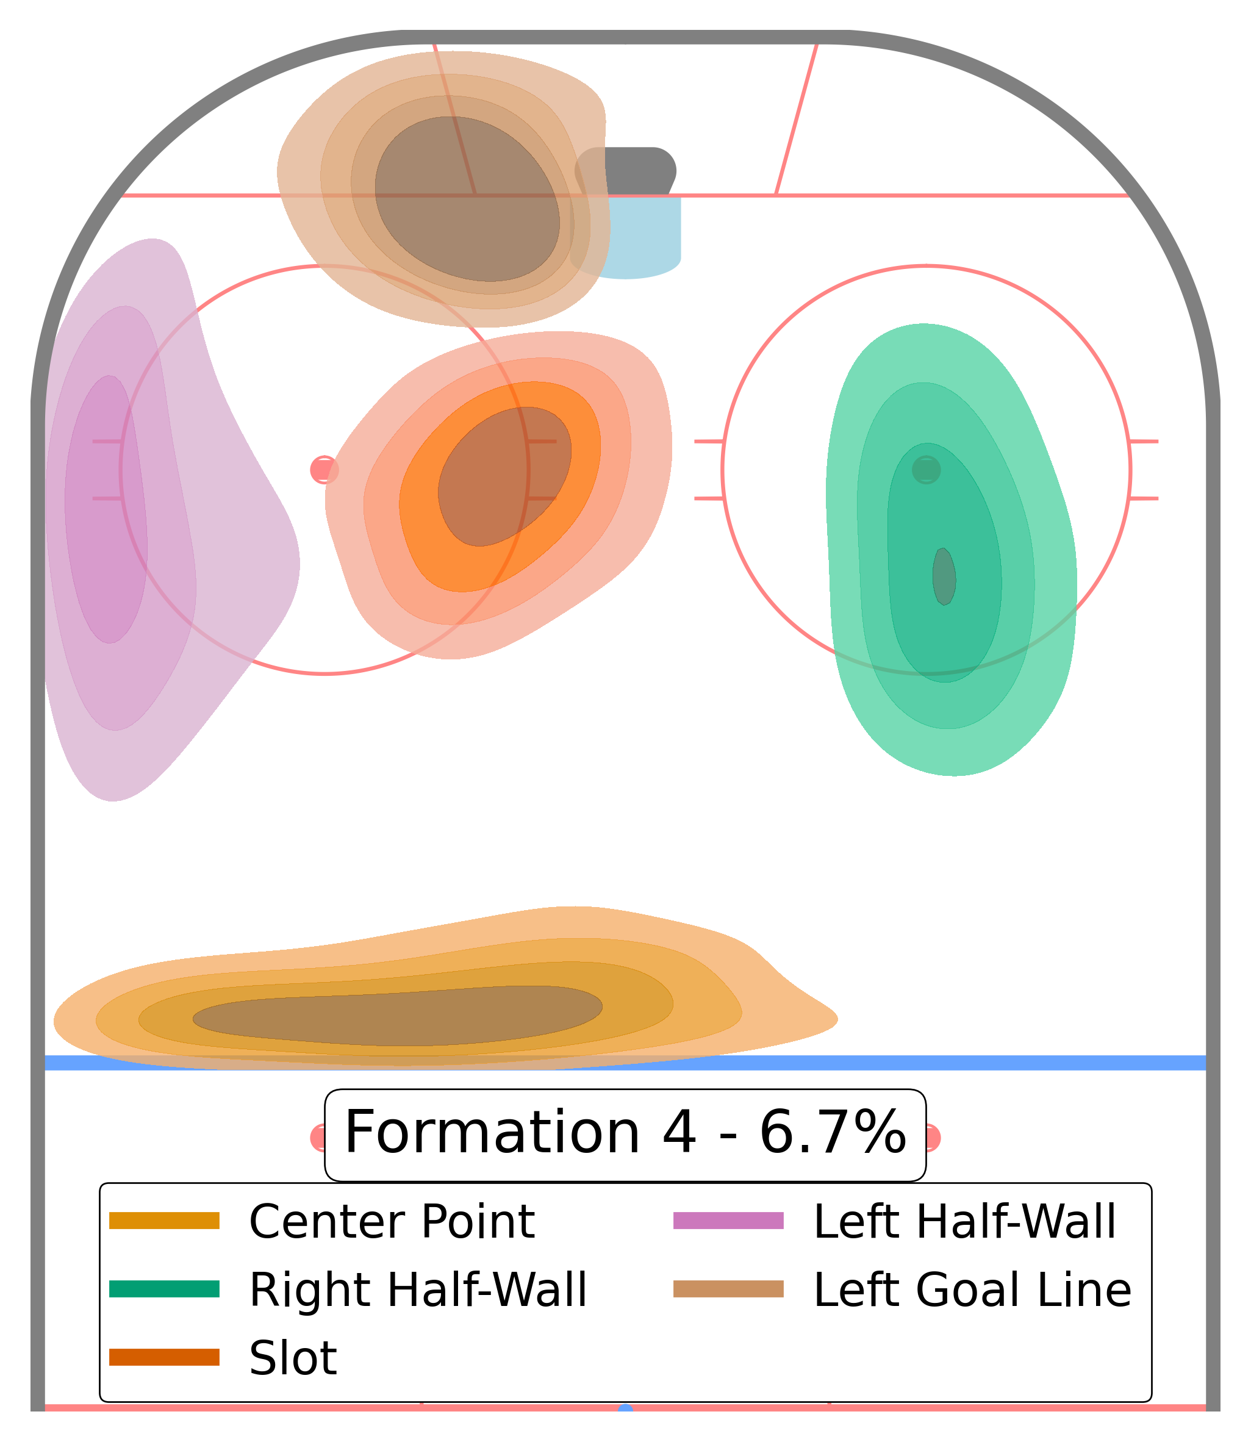
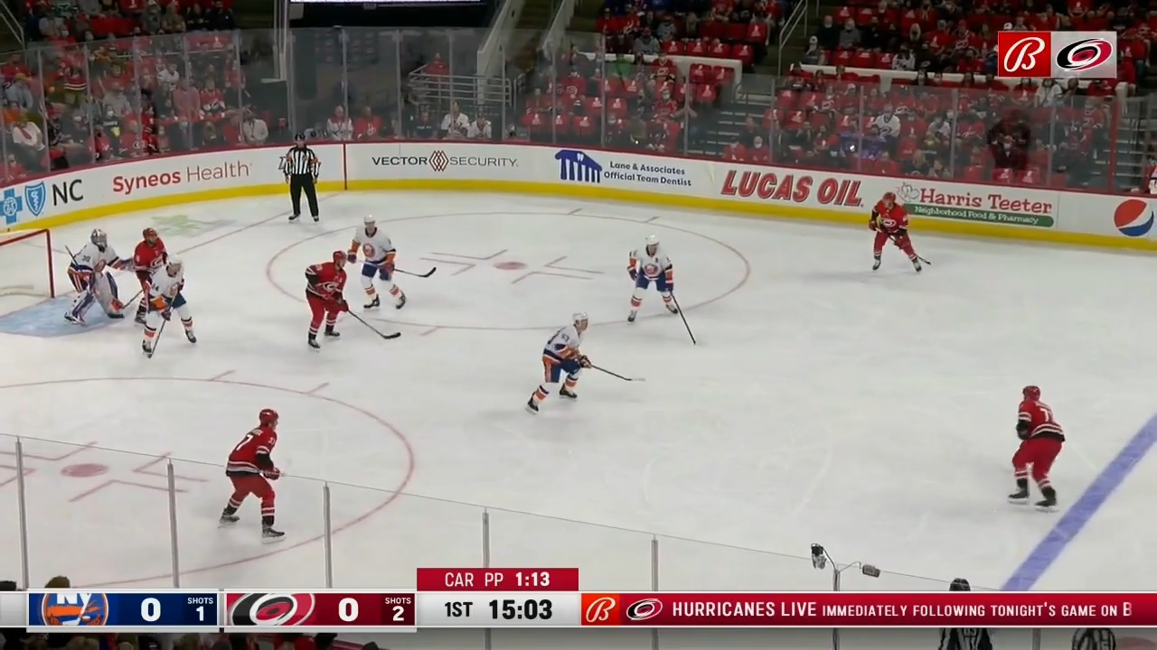
Formations in Game Situations
Notes:
Here, we have an example where the hurricanes in red are on the powerplay in the base formation. The puck is at the point. We can imagine from the formation a few scenarios playing out. The player may take a shot, or pass for a one-timer on the right side or pass to the left. The formation the team is in at this instant dictates the types of plays that may occur. What happens is the pass is made to the left half wall. When this happens, the net-front player bleeds out to the goal line, opening up a passing lane, and new ways of generating a scoring chance. The pass is indeed made to the goal line and a shot attempt results from it. What I hope to illustrate with this example is that 1) formations are really instantaneous measures of player positioning, as opposed to some macro-level indicator of tactics and 2) the formation a team is in at any instant tells us a lot about the types of plays that are available.

Slide 24
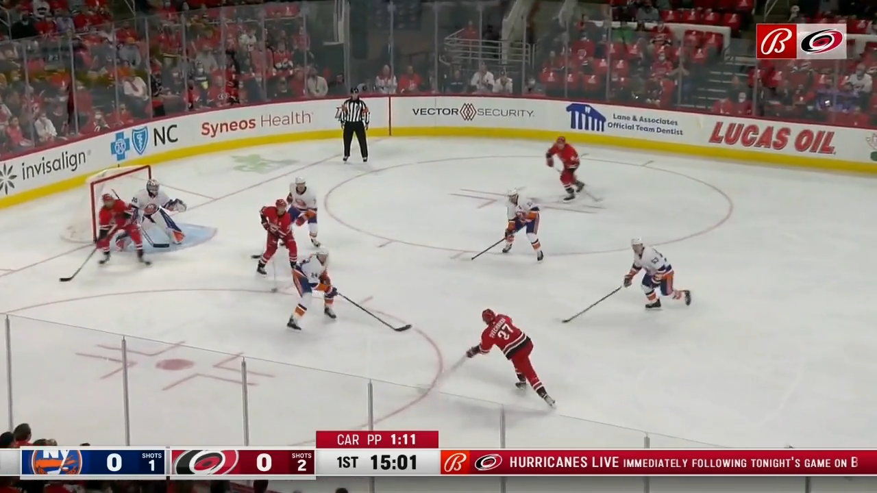
Formations in Game Situations
Notes:
From this base formation, the point player has many options, including a one-timer option on the right side. He opts for a pass to the left side instead, to a player not in a one-timer position. This triggers another formation change, back to the original formation with the net-front player along the goal line. What this example demonstrates is that, in this framework, formations are more an instantaneous measure of player positioning. From a particular formations, certain scoring opportunities may arise, but individual player decision making can quickly lead to a change in formation.

Slide 25
Roles and Formations
Our approach
Identify sequences when the power play is in formation.
Define roles from data using non-negative matrix factorization.
Assign each player a unique role at each time point by solving a linear assignment problem.
Cluster roles together to facilitate the analysis of player deployment.

Slide 26
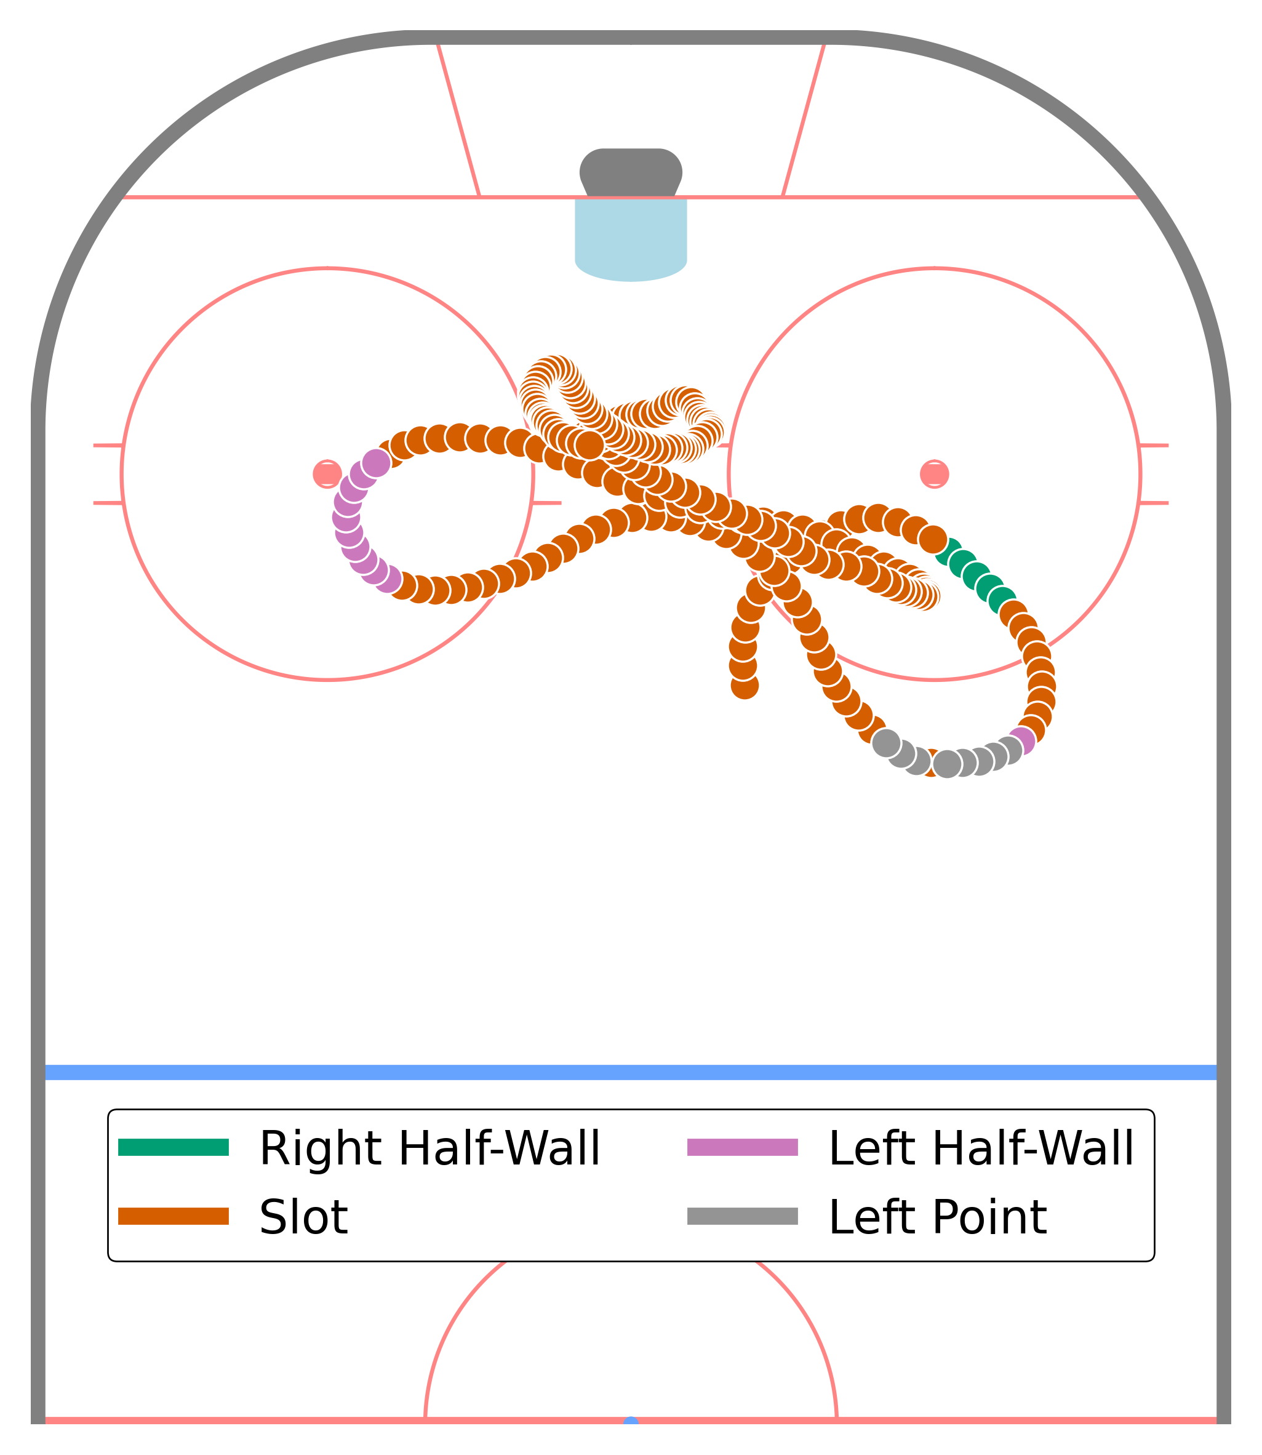
Assigned Roles
Players do not stay in the same role for the duration of a possession.
For a given possession, players may be assigned to a specific area of the ice → assigned roles
To find these assigned roles, the percentage of time a player spends in each role in each possession is used as the input in a K-means clustering model.
Notes:
As is on slide

Slide 27
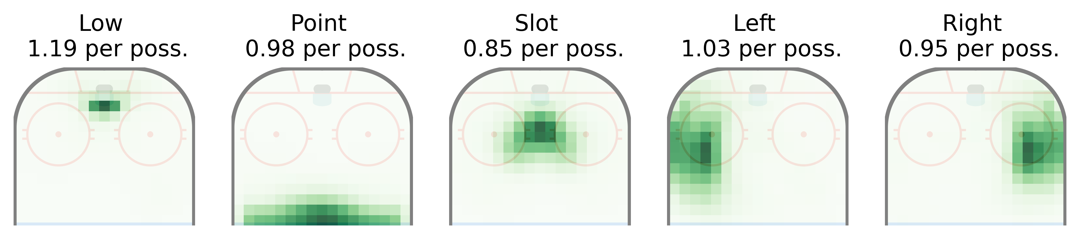
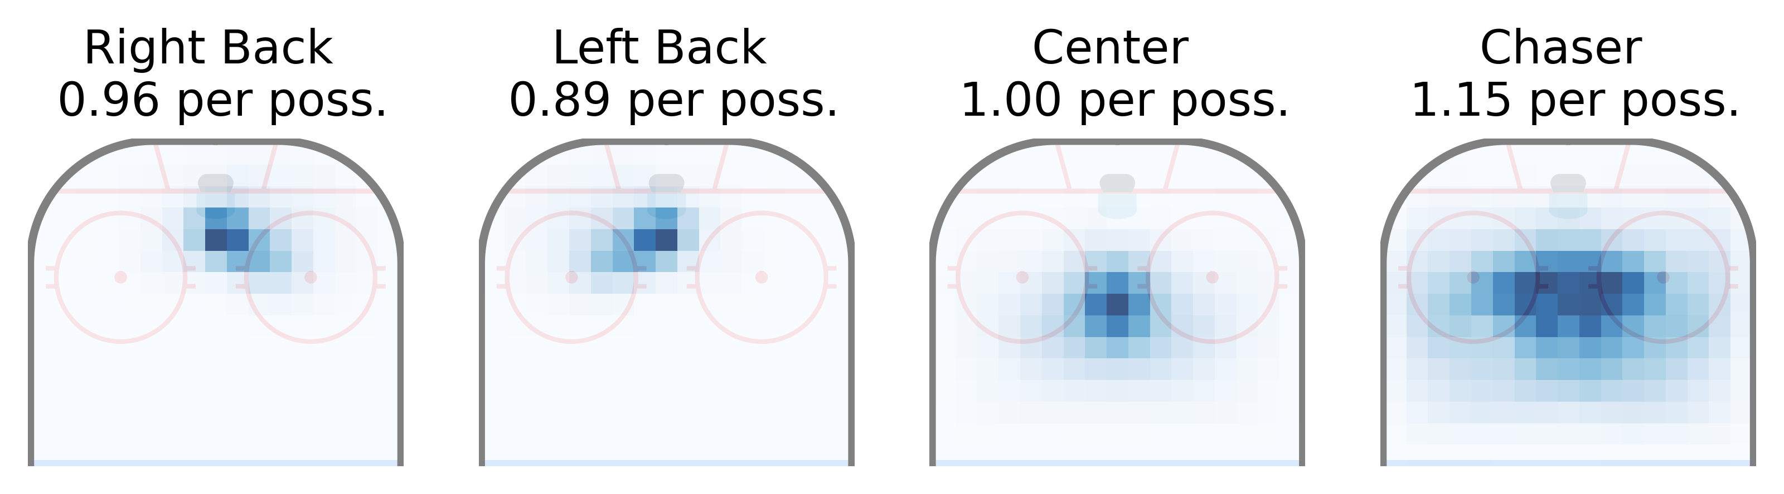
Assigned Roles
Each assigned role is a weighted sum of our previous roles.
Assigned roles at each possession are no longer unique.
Power Play
Penalty Kill
Notes:
A natural number of assigned roles to use on the power play is 5. The assigned role definitions are shown in here. Importantly, these assigned roles are not unique. For example, on average, in each possession, 1.19 players are assigned to “low”. These 5 assigned role neatly correspond to our base formation.

Slide 28
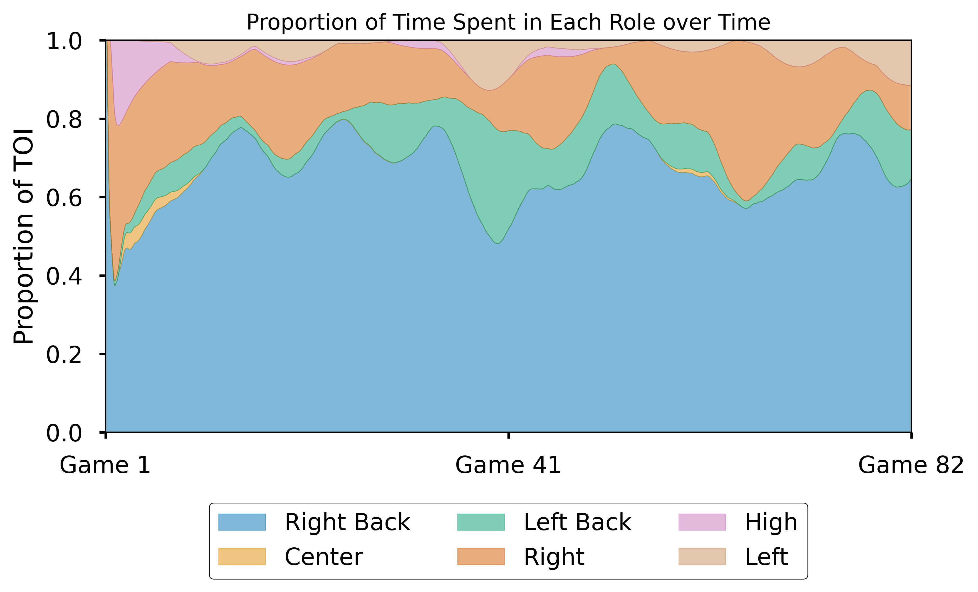
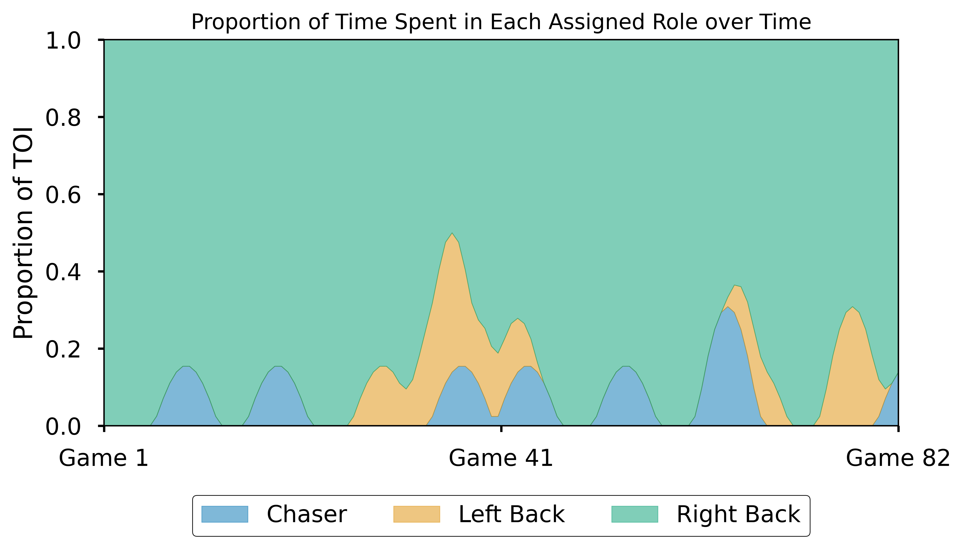
Measuring Deployment: Penalty Kill
How assigned roles can improve interpretability
A player’s deployment can be analyzed in detail using roles.
While less detailed, assigned roles provide a more stable measure of deployment.
Notes:
How are these assigned roles useful compared to the roles we had before? Let’s use the example of measuring player deployment on the penalty kill. Here we plot the proportion of time spent in each role over the course of last season. Using roles, we can see that example player played mostly and the right side, with some time on the left halfway through the season. This is immediately clear if we use assigned roles. The Right Back assigned role is almost always in the majority.

Slide 29
Applications
Using roles and formations to improve player evaluation
The methodology we have laid out yields a rich data set with numerous possible applications.
Adjust player production (goals, assists, points, expected goals) for their deployment.
Compare the performance of a team with and without a player in a certain role.
Develop a model to measure role-specific player impact.

Slide 30
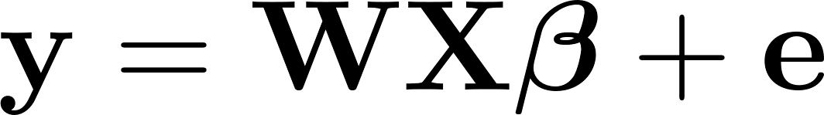
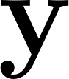




Regression Model for Role-Specific Impact
Regression-based methods are frequently used to isolate player ability independent of their teammates, opponents and other variables that may be out of their control [1, 2].
Model:
- Expected goals per 60 minutes generated by the offensive team during the possession
- Design matrix
- Regression coefficients
- Weights related to the duration of each possession
- Model error
[1] B. Macdonald, “Adjusted Plus-Minus for NHL Players using Ridge Regression with Goals, Shots, Fenwick, and Corsi,” Journal of Quantitative Analysis in Sports, vol. 8, no. 3, pp. 1–24, 2012.
[2] M. B. McCurdy. “The Magnus Prediction Model, version 6,” HockeyViz, 2022.

Slide 31
Regression Model for Role-Specific Impact
Design matrix
Each player in the dataset is associated with 9 design variables.
One for each of the 5 assigned roles on the power play
One for each of the 4 assigned roles on the penalty kill
Four additional design variables are included that encode whether the team on the power play
is using 4 forwards or more,
is playing at home,
has a left-shot playing the right side, and
has a right-shot playing the left side.
After removing player-role combinations that are never observed, we are left with 3649 regression coefficients to estimate from 9347 observations.

Slide 32
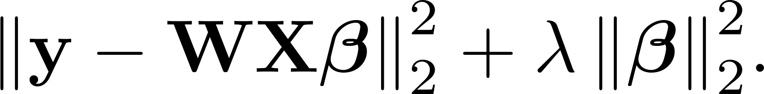
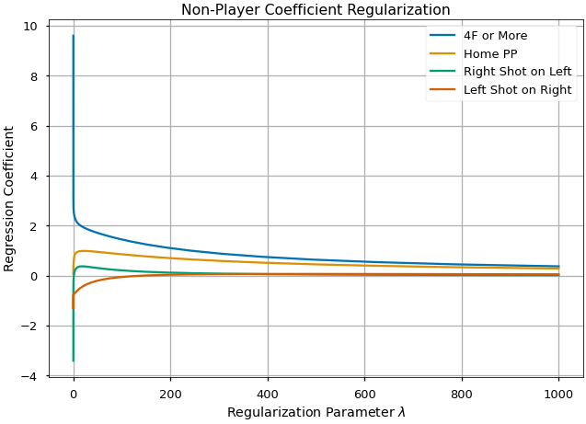
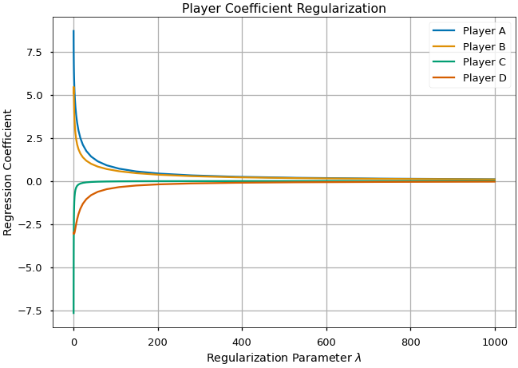
Regression Model for Role-Specific Impact
Ridge Regression
In ridge regression, we minimize the objective function
Small sample size and collinearity → Large regularization parameters

Slide 33
Regression Model for Role-Specific Impact
Results
Results are reported as the relative impact on the offensive team’s expected goals rate.
Variable | Relative Impact
4F or More | 4.16%
Home PP | 2.94%
Left Shot on Right | 0.44%
Right Shot on Left | 0.29%
Notes:
League average: 15.20 xG per 60

Slide 34
Regression Model for Role-Specific Impact
Results
Power Play
 | Low | Slot | Left | Right | Point
Best Relative Impact | 2.89% | 1.34% | 2.23% | 2.79% | 1.75%
Worst Relative Impact | -1.04% | -0.86% | -0.96% | -1.07% | -1.48%
Penalty Kill
 | Right Back | Left Back | Center | Chaser
Best Relative Impact | -0.85% | -0.89% | -1.04% | -0.90%
Worst Relative Impact | 1.64% | 1.45% | 1.23% | 1.05%
Notes:
At the assigned role level, the player with the highest individual impact increased hi team’s xG rate by almost 3% when playing the low role. The player with the worst relative impact was a player playing the point, which is interesting because the players with the worst relative impacts on the penalty kill were also assigned roles that were more defensive. Maybe this says something about our ability to evaluate defensemen, or it could just be the small sample size effect.

Slide 35
Summary and Future Work
Summary
Future Work
Defined roles
Identified formations
Stabilized results through assigned roles
Presented a framework for a regression-based method for player evaluation
Definition of possessions
Handedness
Dynamics of special teams through roles swaps and formation change
Passing tendencies

Slide 36
Supplementary Material

Slide 37
Player Positioning: Roles and Formations
Players have roles and organize themselves in formations.
Right
Net Front
Point
Slot
Left
Notes:
To analyze player positioning, we use a framework based on roles and formations. As we saw, there are already well-defined spatial roles on the power play. The concept of formations then arises by looking at the spatial distribution of these roles. These concepts are present both on the power play and the penalty kill.

Slide 38
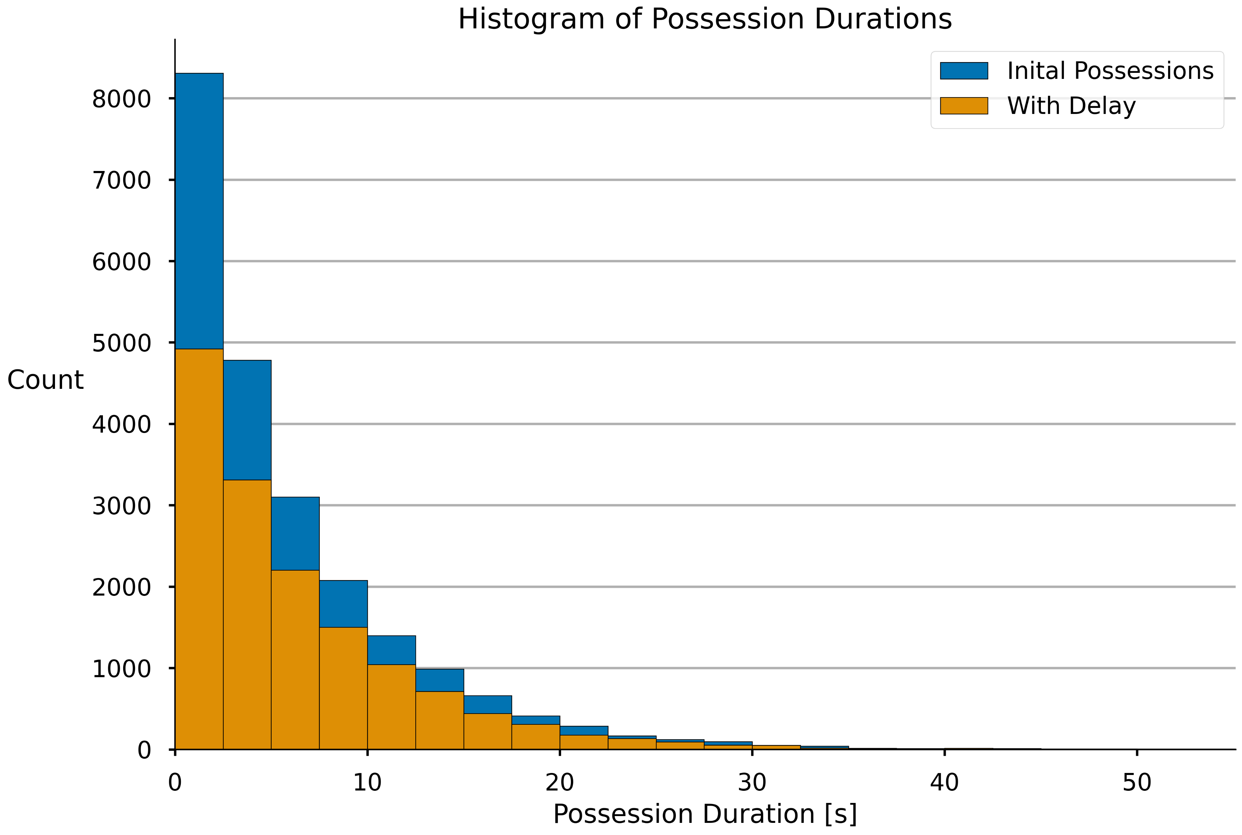
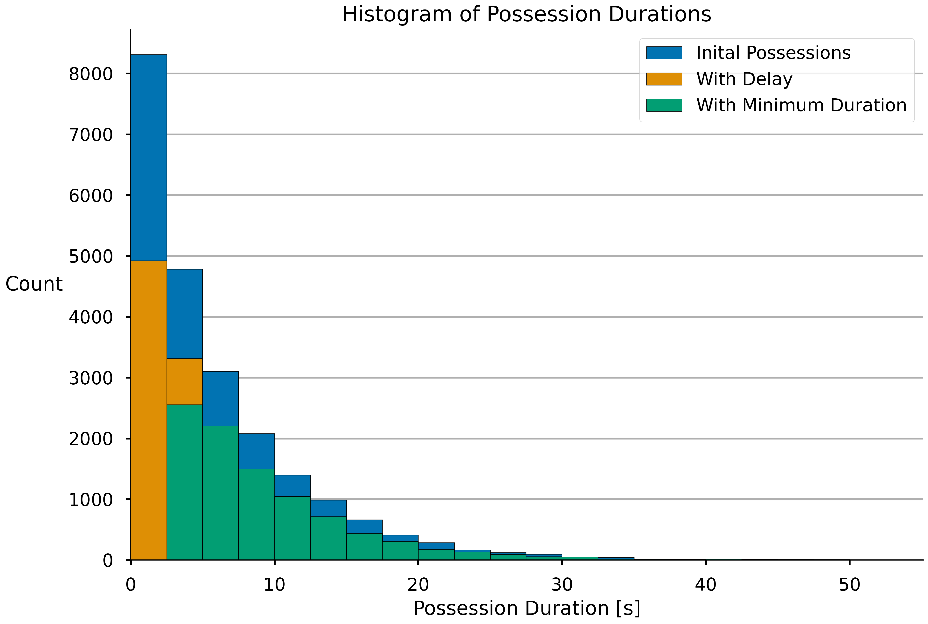
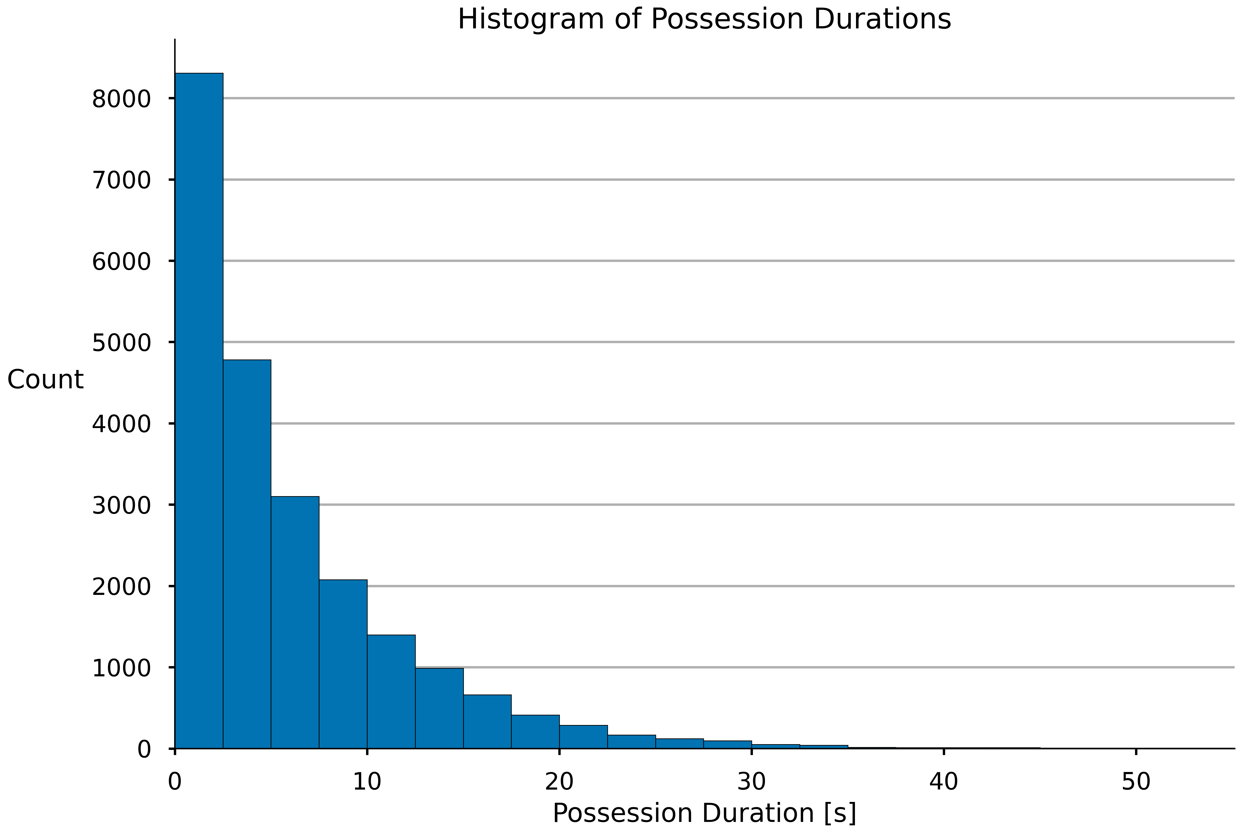
Refining Possessions
To further isolate possessions:
Remove first 2 seconds of each possession to allow offense to organize.
Restrict possessions to minimum of 3 seconds.
Possession A: 8s total
✓
2s
6s remaining
Possession B: 4s total
✗
22566 possessions
5.60s average duration
9347 possessions
9.20s average duration
15029 possessions
6.24s average duration
2s
2s
Notes:
We have a rough idea of when the offensive team might be in possession. Consider two possessions, A and B lasting 8 and 4 seconds, respectively. To further isolate possession, we remove the first two seconds to allow the offense to organize. Doing so reduces the number of possessions to 15029 and increases the average duration to 6.24s. We next restrict possessions to a minimum of 3s. After processing, this means possession A remains a valid possession lasting 6s and possession B is discarded as it would only last 2s. Our final dataset contains 9347 with an average duration of 9.2s.

Slide 39
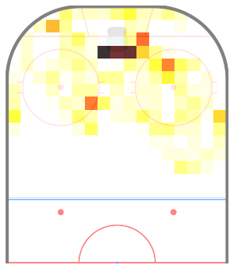
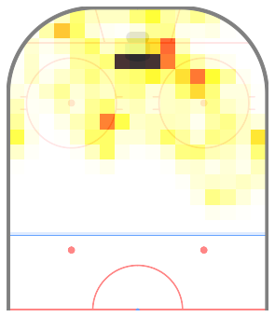


Defining Roles
Decreasing the noise
To reduce noise caused by sample size effects, a Gaussian blur is applied to the individual player count matrices.
Without Smoothing
With Smoothing
Notes:
The arbitrary binning of the ice and the small sample for certain players can lead to noisy data. To mitigate this, a Gaussian blur is applied to the individual player count matrices like the one shown on the last slide. This helps even out the distribution a little bit. It’s clearer if we zoom in on a specific region of the ice.

Slide 40
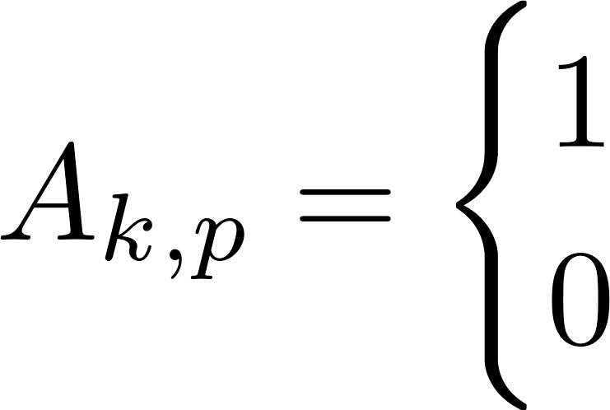



Determining Role Allocation
Given the role definitions, we now want to determine which player is occupying which role at each time point.
Two players cannot occupy the same role at the same time.
Let $C$ be a $K×P$ matrix, where $C_{k,p}$ is the cost of assigning player $p$ to role $k$.
Let $A$ be a $K×P$ matrix, where
Solve for $A$ that minimizes .
if player $p$ occupies role $k$,
otherwise.

Slide 41





Determining Role Allocation
Computing the cost
The cost is
is the probability of the player in location $ℓ$occupying role $k$.
is the probability of the player occupying role $k$.
is the probability of the player occupying location $ℓ$.
The information required to compute each of these terms can be found in the basis and weight matrices.
Notes:
The results of the NMF contains all the information we need to compute the cost of allocating player p to role k.
The basis

Slide 42


Formations
Formations arise naturally from uniquely assigning roles.
They are found by extracting all unique combinations of roles.
Using 9 roles, there are 126 possible power play formations.
Using 6 roles, there are 15 possible penalty kill formations
Power Play
Penalty Kill
Notes:
Formations arise naturally from uniquely assigning roles. They are found by extracting all unique combinations of roles. On Using 9 roles, there are 126 possible power play formations. Most of these formations are rarely observed. On the penalty kill, there are only 15 possible formations.

Slide 43


Measuring Deployment: Power Play
How assigned roles can improve interpretability
Similar gains in stability are made when looking at power play deployment.
Notes:
Similar gains in stability are made when looking at power play deployment. While we do get the added distinction of know that the player played mostly on the left goal-line when not in the net front, the assigned role plot is undoubtedly easier to interpret.

Slide 44
Role-Specific Player Ability
Adjusted player production
Adjusting for deployment, we can more easily compare players with different deployments.
Assigned Role | ixG60
Low | 4.11
Slot | 3.57
Right | 3.16
Left | 3.14
Point | 1.14
Example Player | Low | Slot | Left | Right | Point | ixG60 | Role-Adjusted ixG60
Low Forward | 36.89 | 1.16 | 0 | 1.13 | 0 | 3.66 | 1.70
Point Defenseman | 0.00 | 0.68 | 1.48 | 1.00 | 30.71 | 0.67 | 2.06
Notes:
Adjusting for deployment, we can more easily compare players with different deployment profiles. For example, if we have one player who is assigned to almost exclusively play low in the zone, we expect them to generate more individual expected goals per 60 than a defenseman assigned to exclusively playing the point. If we adjust for deployment, however, we see that in the case, the point defenseman generates more offense than the low forward.

Slide 45

Role-Specific Player Ability
Histogram of target variable
Notes:
Adjusting for deployment, we can more easily compare players with different deployment profiles. For example, if we have one player who is assigned to almost exclusively play low in the zone, we expect them to generate more individual expected goals per 60 than a defenseman assigned to exclusively playing the point. If we adjust for deployment, however, we see that in the case, the point defenseman generates more offense than the low forward.

Slide 46

Regression Model for Role-Specific Impact
Results

Slide 47


Regression Model for Role-Specific Impact
Results

